Slide 1
Three Cases of Chemical Differentiation in Disk-Forming Regions of
Low-Mass Protostellar Sources
Yoko Oya
The University of Tokyo, Japan
Main Collaborators:
Satoshi Yamamoto, Muneaki Imai (U. Tokyo)
Nami Sakai (RIKEN),
Cecilia Ceccarelli, Bertrand Lefloch (U. Grenoble)

Slide 2
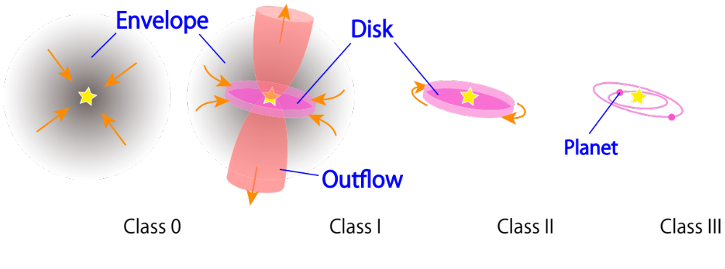
Low-Mass Protostellar Evolution
When and how are disks formed from envelopes?
  Physical evolution
    How does the envelope gas fall into disks?
  Chemical evolution
    How does the chemical composition change during the disk formation?
Missing Link

Slide 3
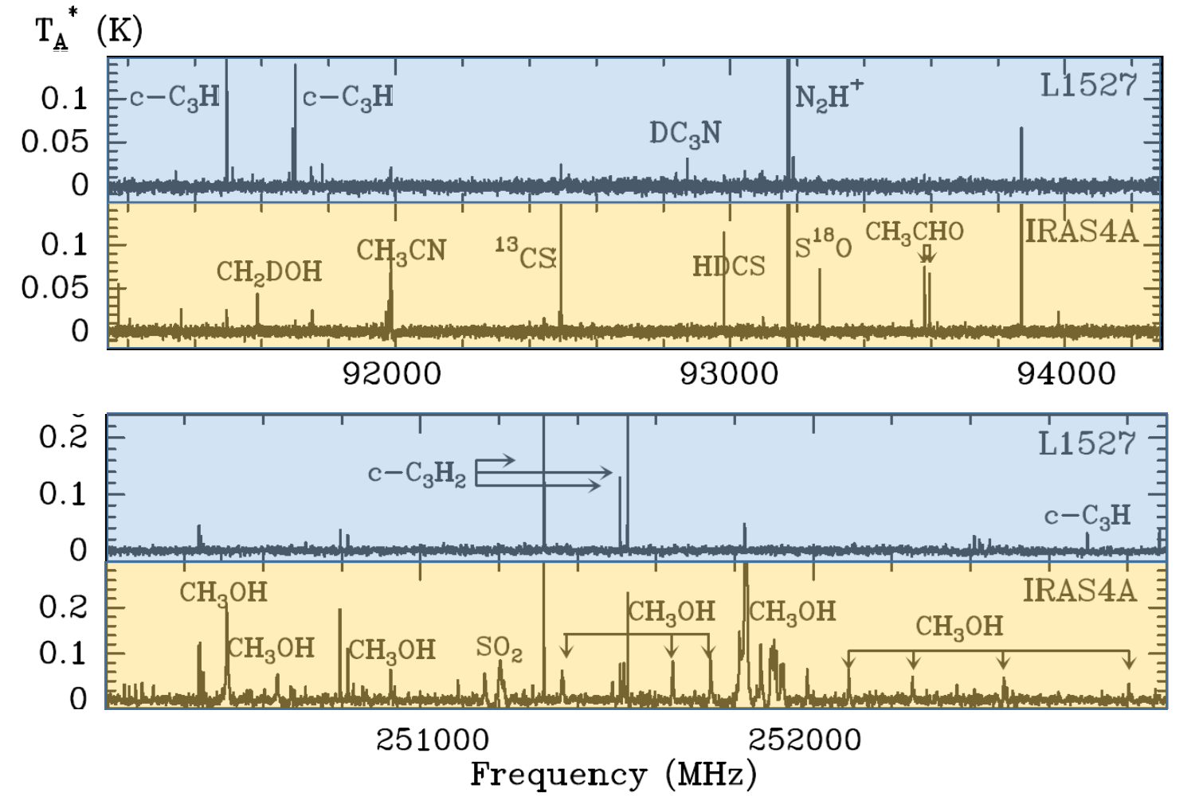
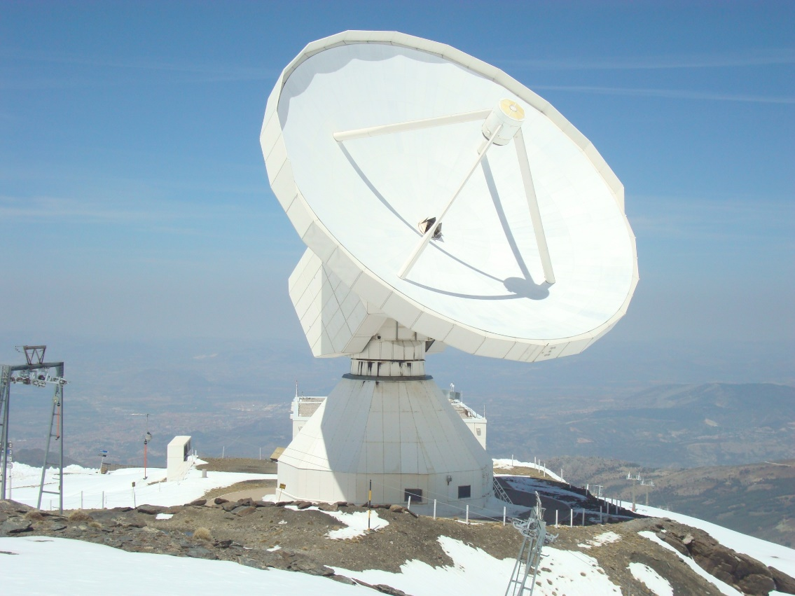
Chemical Variation in Low-Mass Sources
WCCC source
Hot corino
(Lefloch, et al. 2018)

Slide 4
Chemical Variation in Disk-Forming Regions
ALMA view of chemistry in young low-mass sources
1. Warm carbon-chain chemistry sources
2. Hot corino sources
3. Hybrid sources
4. Unified Picture
  − L1527
  − IRAS 16293-2422
  − L483 & B335

Slide 5
1. Warm Carbon-Chain Chemistry Sources
L1527
Infalling-Rotating Envelope model
Chemical Change

Slide 6
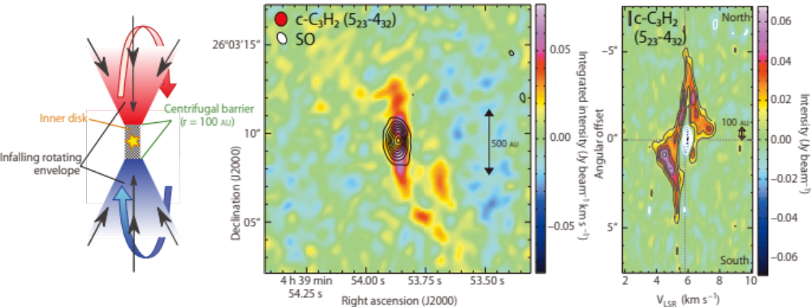
1. WCCC: L1527
  IRAS 04368+2557
    Class 0/I protostar in Taurus (d = 137 pc)
  Warm carbon-chain chemistry
  ↓c-C₃H₂ observed with ALMA (Sakai et al. 2014a)
    Resolution: ~0”.9, ~0.15 km/s
    Spin-up structure

Slide 7
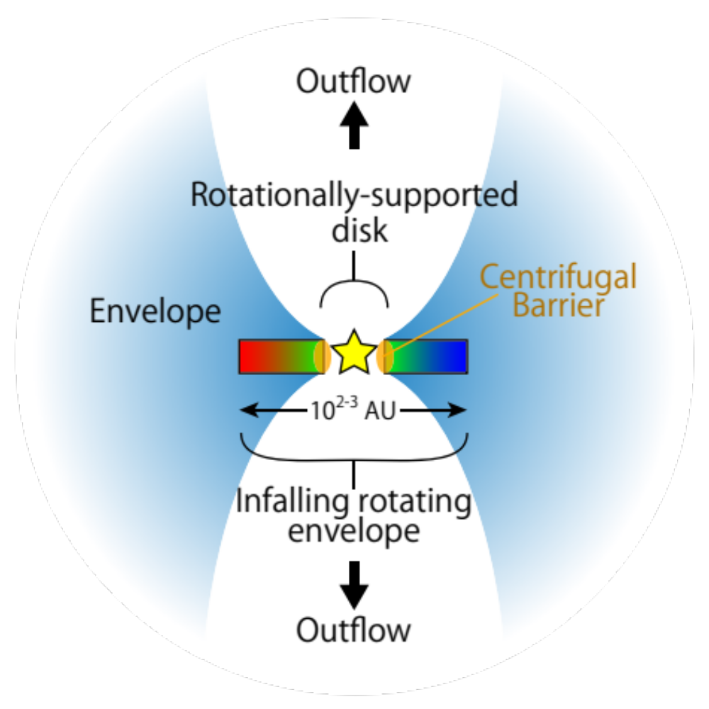
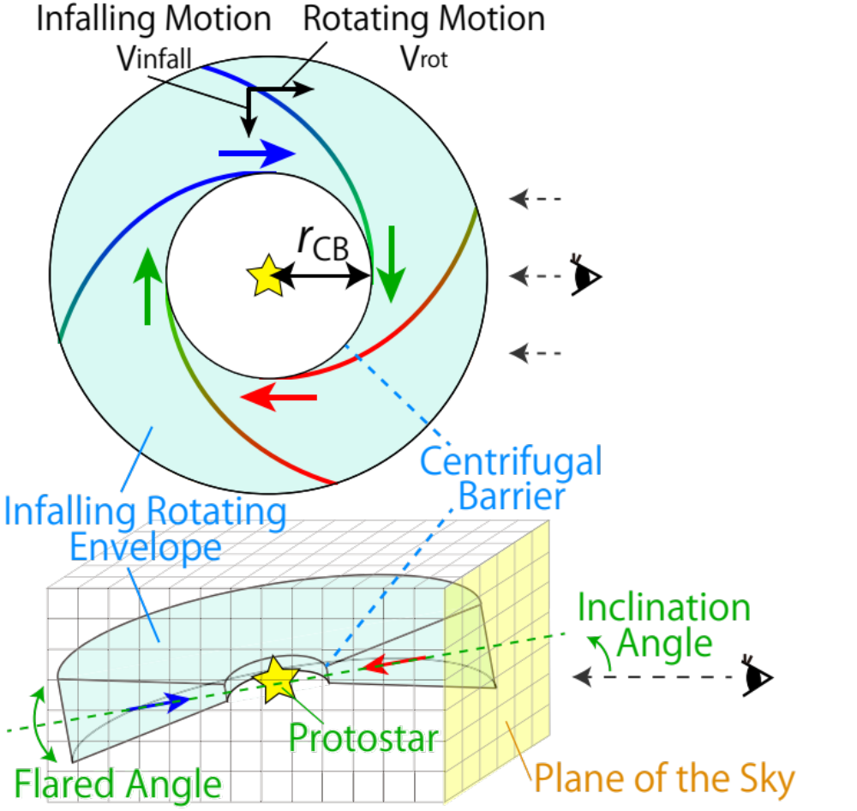
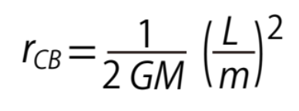
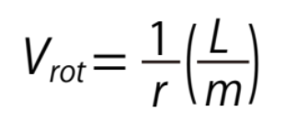
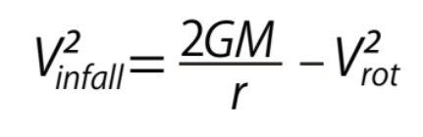
1. WCCC: Infalling-Rotating Envelope
Assumptions
  Particle motion
  Optically thin, n ∝ r ^{-1.5}
  Convolution: Line width, Resolution
Parameters
  M: Mass
  r_{CB}: Radius of the CB
Velocity Field
  i: Inclination angle
(Oya et al. 2014)

Slide 8
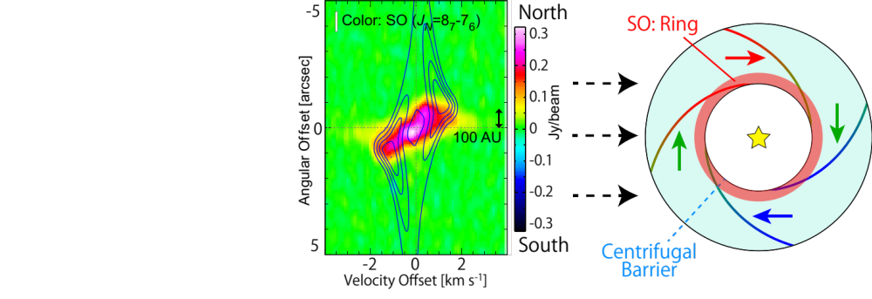
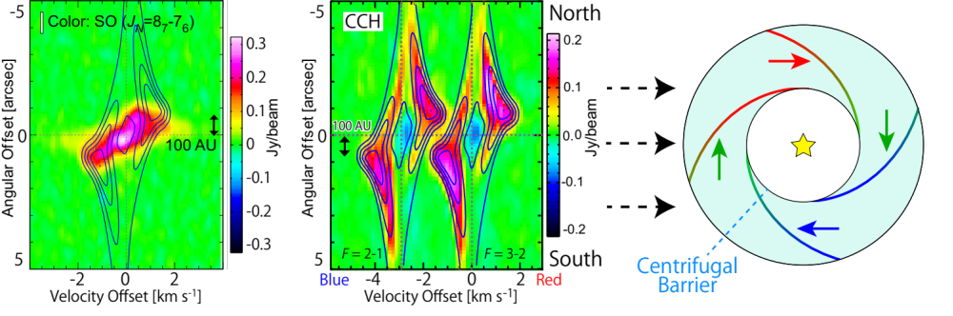
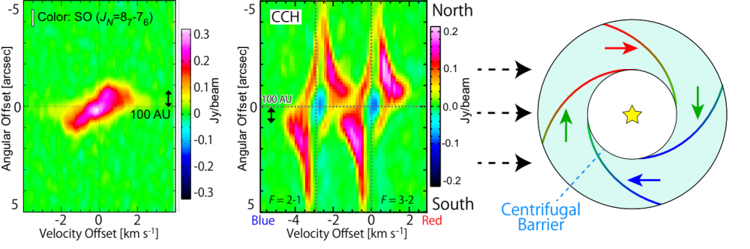
1. WCCC: L1527
See also
P18 by Ilee,
P25 by Maureira
Infalling-rotating envelope model for L1527
→ r_{CB} = 100 ± 20 au, M = 0.18 ± 0.02 M⦿ (i = 85º) (Sakai et al. 2014a,b)

Slide 9
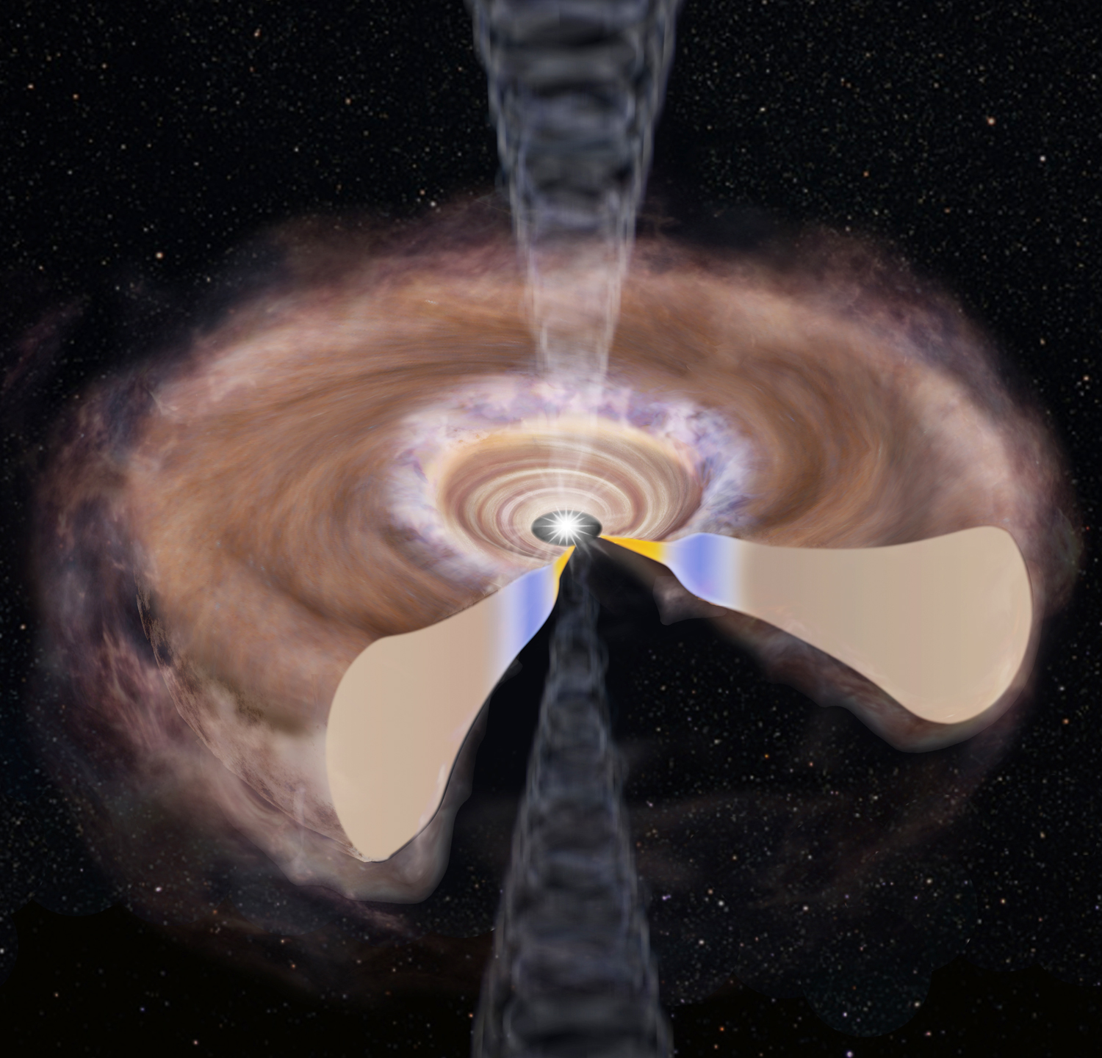
1. WCCC: Drastic Chemical Change
H₂CO, SO, (CH₃OH)
SO enhancement
Disk
Centrifugal Barrier
Infalling-Rotating Envelope
CCH, c-C₃H₂, CS, H₂CO
Sakai et al. Nature, 507, 78 (2014)
Sakai et al. ApJ, 791, L38 (2014)

Slide 10
2. Hot Corino Sources
IRAS 16293−2422 Source A
Comparison with WCCC Sources

Slide 11
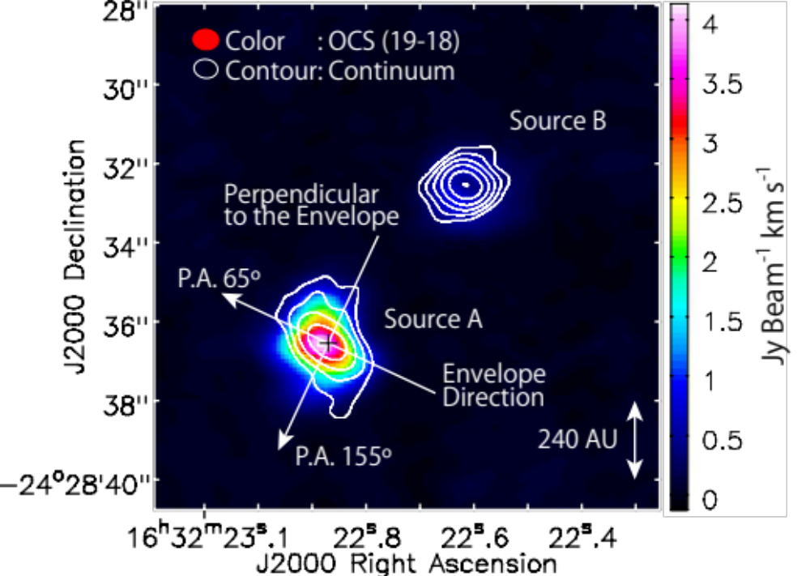
2. Hot Corino: IRAS 16293−2422
Well-studied low-mass star forming region (Class 0)
In Ophiuchus
  Distance
    d = 137~147 pc
    (Ortiz-León et al. 2017)
    d = 120 pc
    (Chandler et al. 2005)
Prototypical hot corino
  Complex organic molecules
  (COMs)
Rotation Motion
  In Source A
  e.g. C¹⁷O, C³⁴S (SMA + eSMA)
  (Jørgensen+ 2012; Pineda+ 2012; Favre+ 2014)

Slide 12
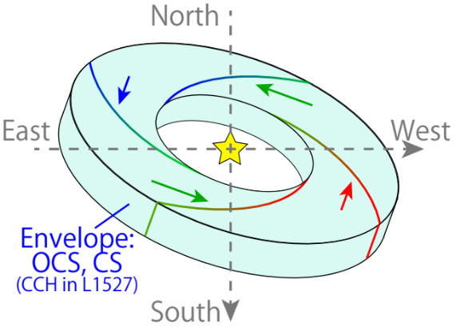
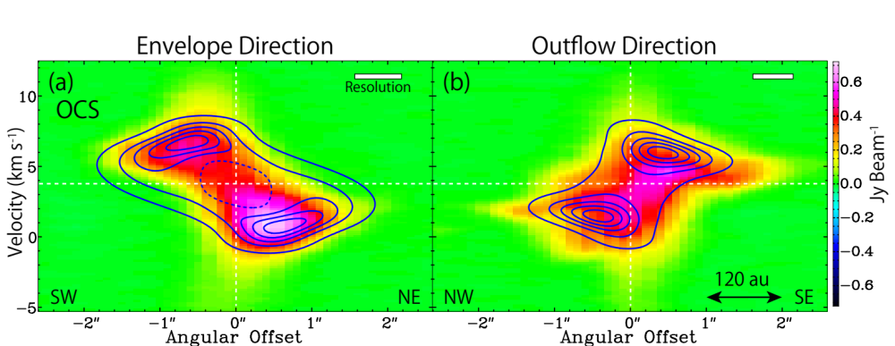
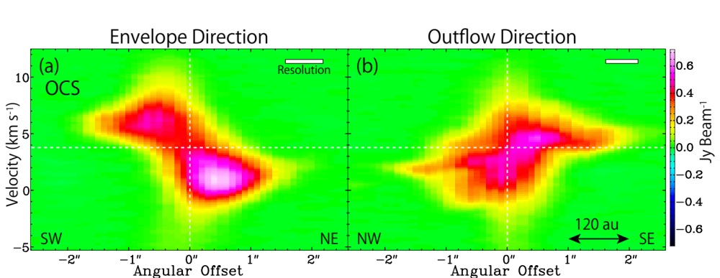
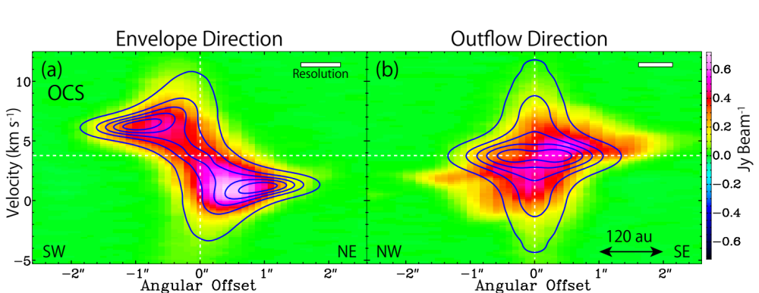
2. Hot Corino: IRAS 16293−2422
Envelope traced by OCS
  Not the Keplerian motion (1.5 M⦿)
  IRE model
    M = 0.75 M⦿, r_{CB} = 50 au
    i = 60º, R_{out} = 180 au
Direction Perpendicular to the Envelope
OCS: color
Model: contour
Rotating
Infalling

Slide 13
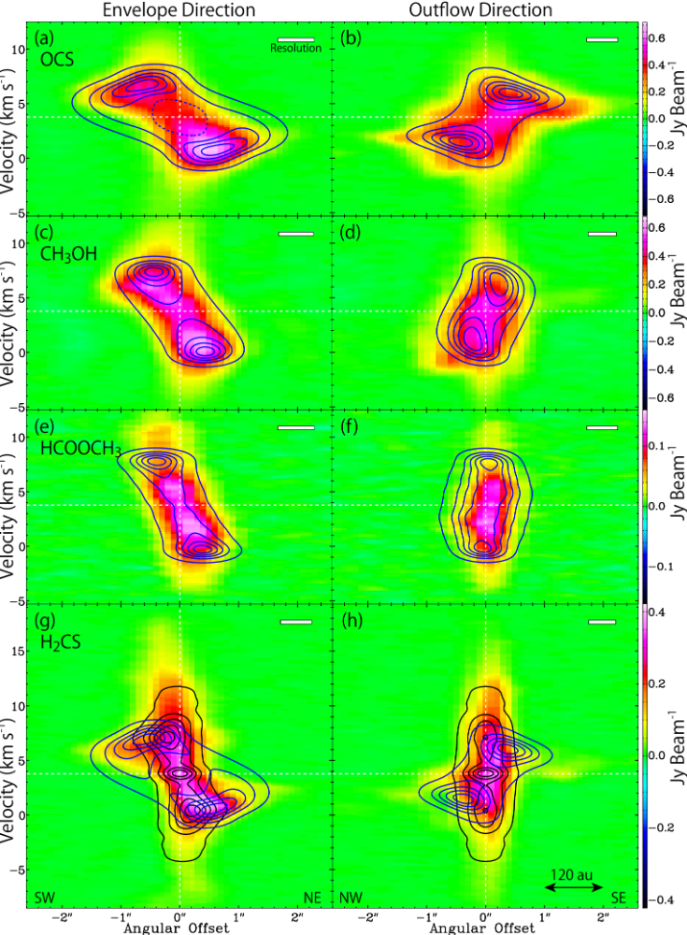
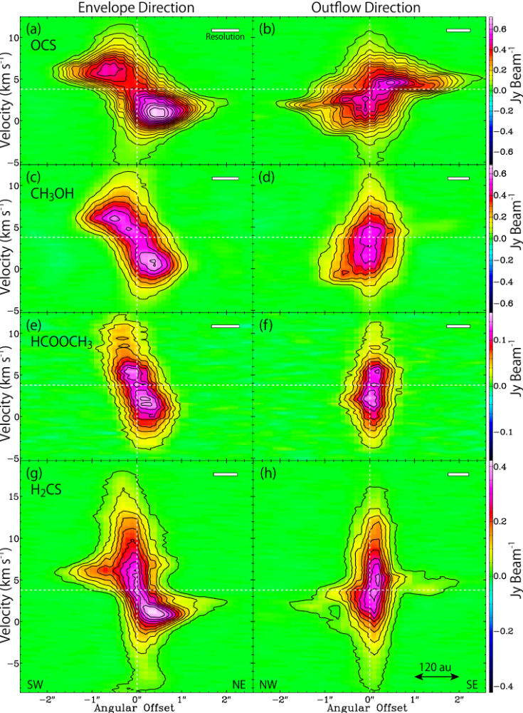
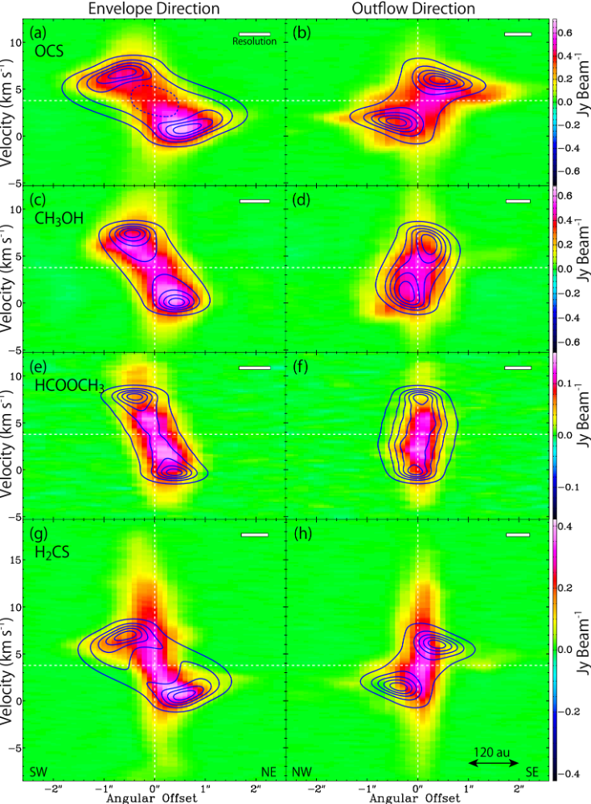
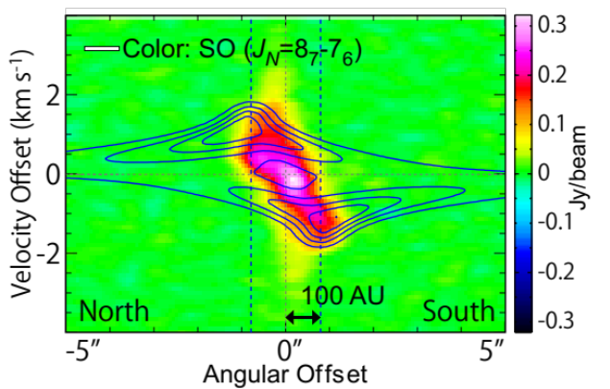
2. Hot Corino
Direction Perpendicular to the Envelope
CB
OCS (19-18)
  Infalling-rotating envelope
CH₃OH (11_{0,11}-10_{1,10}; A⁺⁺)
  Rotating around CB
HCOOCH₃ (19_{9,19}-19_{8,11}; E)
  Rotating around CB
H₂CS (7_{0,7}-6_{0,6})
  Infalling-rotating envelope
  + High velocity component
IRE model (i = 60º):
M = 0.75 M⦿, r_{CB} = 50 au
(R = 180 au)
(R = 80 au: compact)
(R = 55 au: compact)
(R = 150 au)
SO in L1527
Keplerian
Motion
(M = 0.75 M⦿)

Slide 14
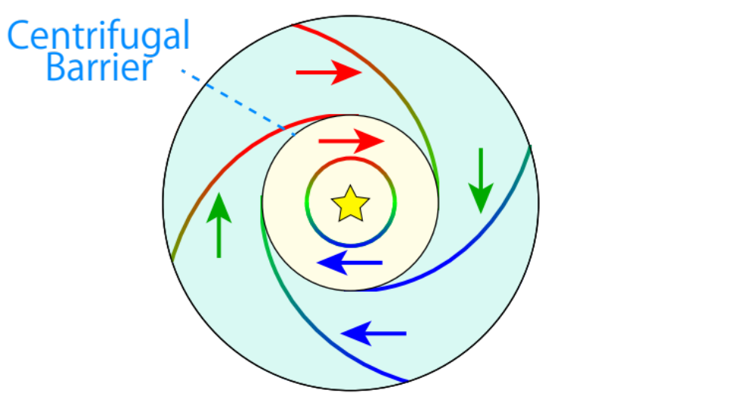
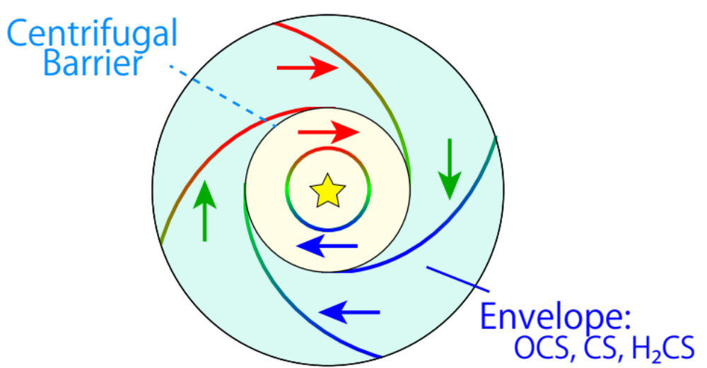
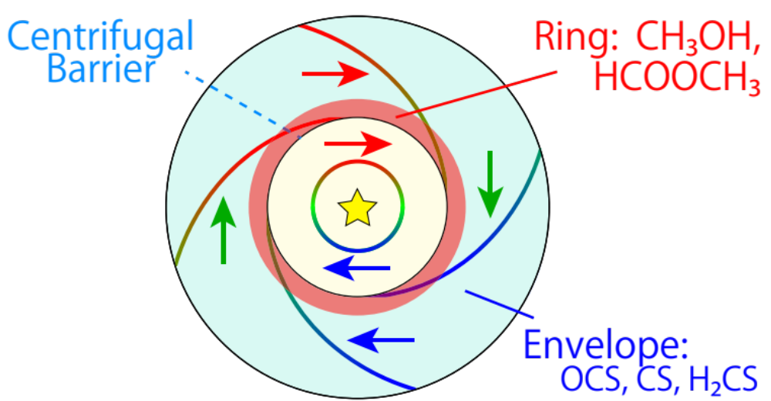
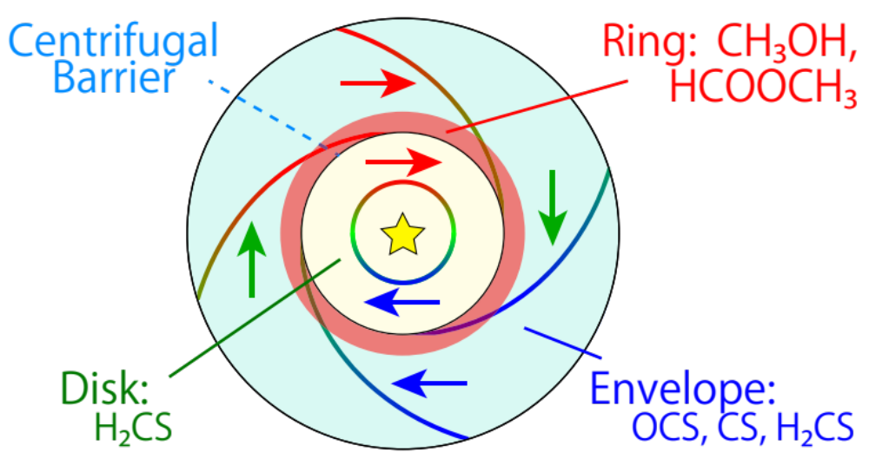
2. Hot Corino: IRAS 16293−2422
Physical conditions causing the chemical change
  T_{kin} is higher at the CB than in the IRE or the disk.
Infalling-rotating envelope is traced by some molecules.
Ring structure is highlighted by COMs.
Disk component inside the centrifugal barrier is detected.
    Thermal heating?
    Accretion shock?
CR
CB
Heating?
Envelope
Disk
Shock?
~100 K ~130 K ~100 K
Enhancement of COMs → Hot Corino Chemistry

Slide 15
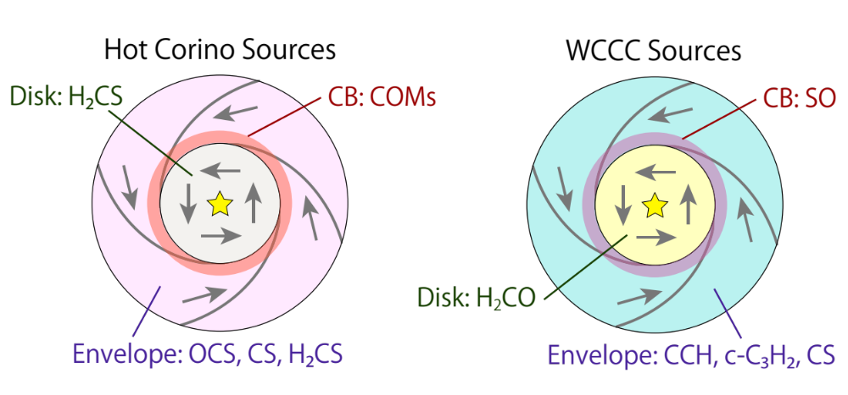
1. WCCC vs 2. Hot Corino
Chemical change at the centrifugal barrier
~10² au
Different tracers for each component in HC/WCCC sources
Chemical variation in the disk formation?

Slide 16
3. Hybrid Sources
L483
B335

Slide 17
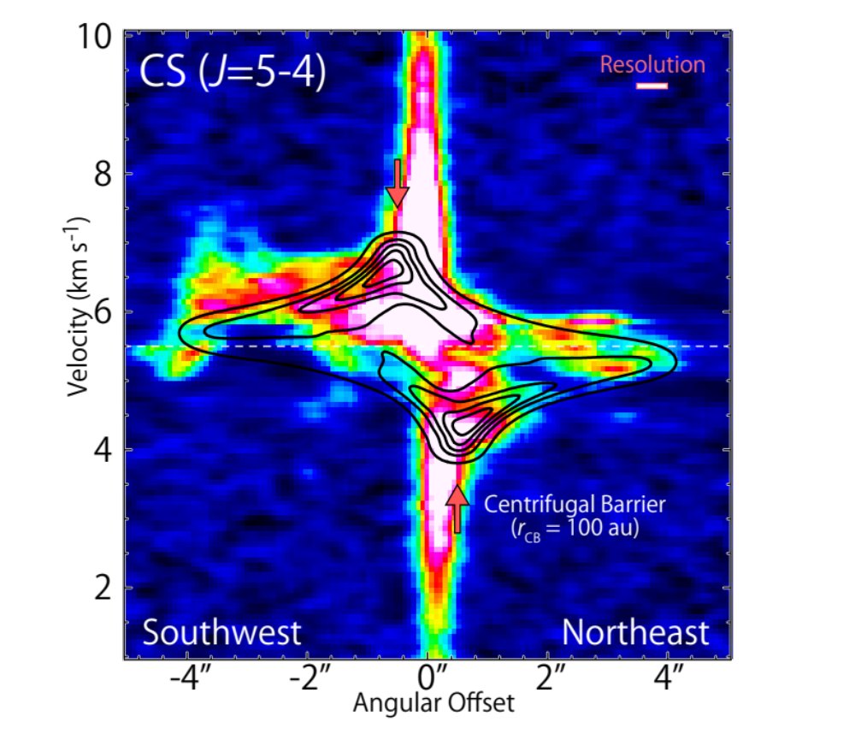
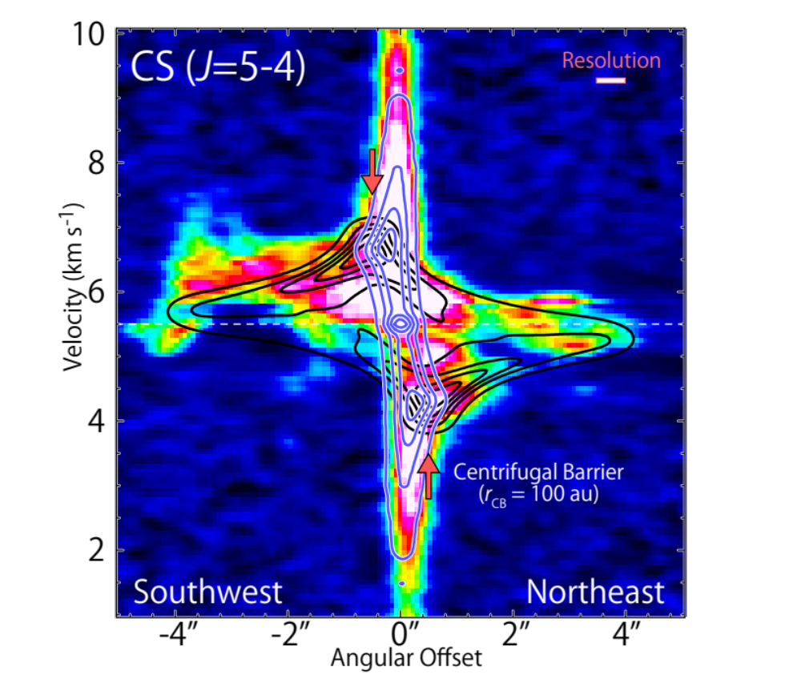
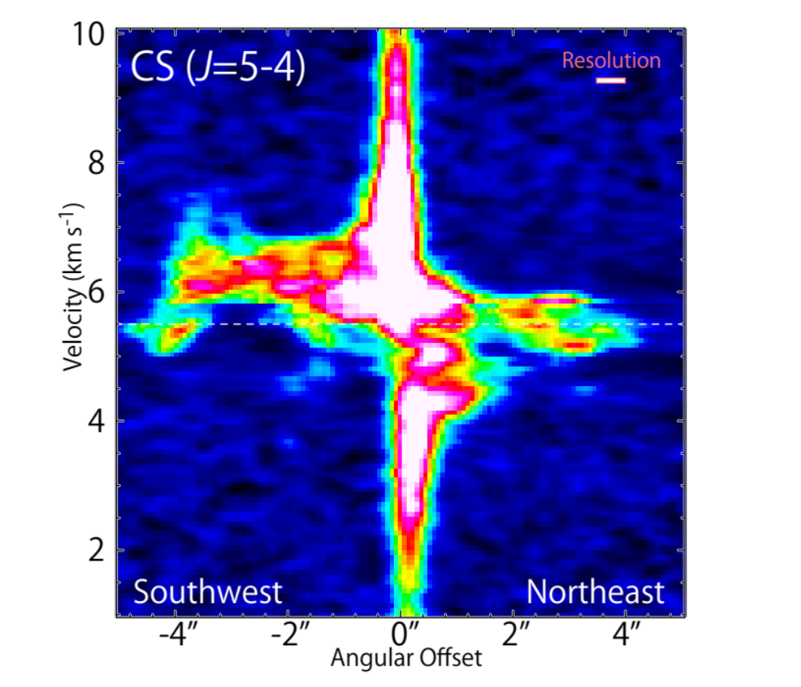
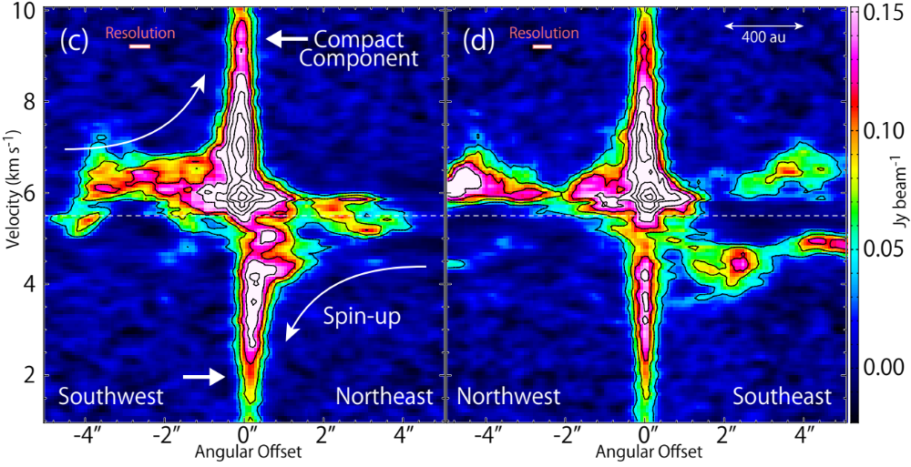
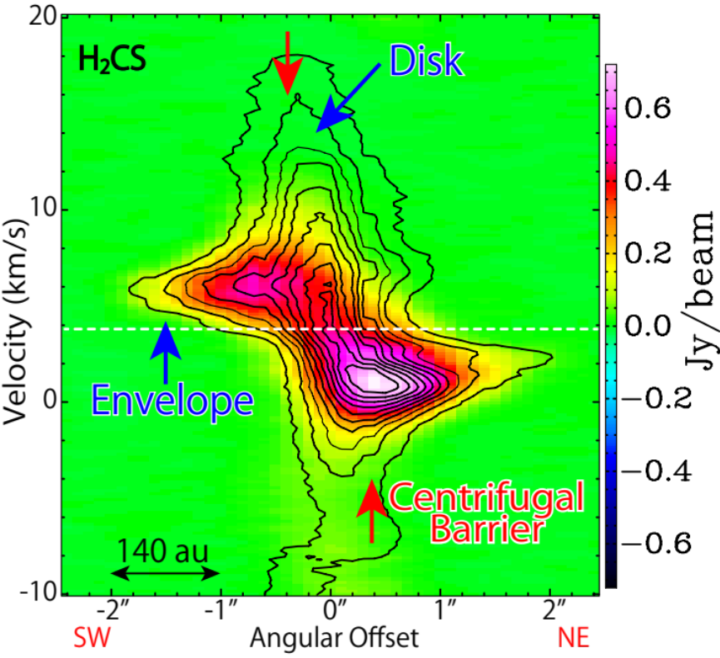
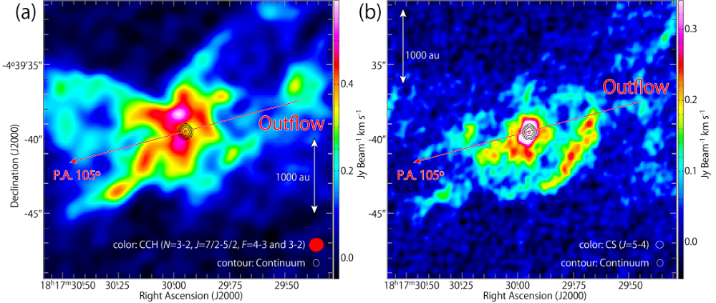
3. Hybrid: L483
Warm Carbon-Chain Chemistry candidate (Hirota et al. 2009)
ALMA Observations (Band 6; Oya et al. 2017)
  CCH
  CS
(Contour)
(IRAS 16293−2422 Source A)

Slide 18
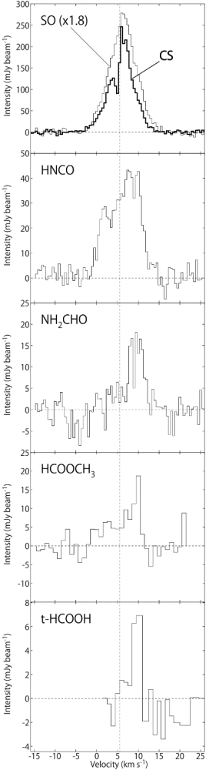
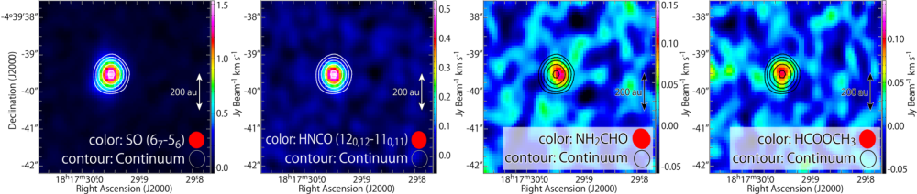
3. Hybrid: L483
Hot corino related species
  NH₂CHO, HCOOCH₃ : marginally detected
→ The first detection of
saturated COMs in the WCCC source

Slide 19
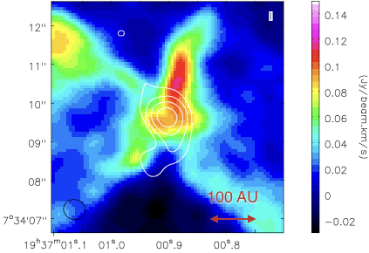
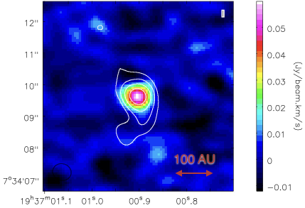
3. Hybrid: B335
IRAS 19347+0727
  Bok Globule
ALMA Cycle 2 Band 6 (Beam ~ 0”.6; Imai et al. 2016)
  CCH (carbon-chains)
    Extended (outflow)
  d = 100 pc (Olofsson & Olofsson 2009)
  HCOOCH₃ (COMs)
    Compact (disk?)
Outflow

Slide 20
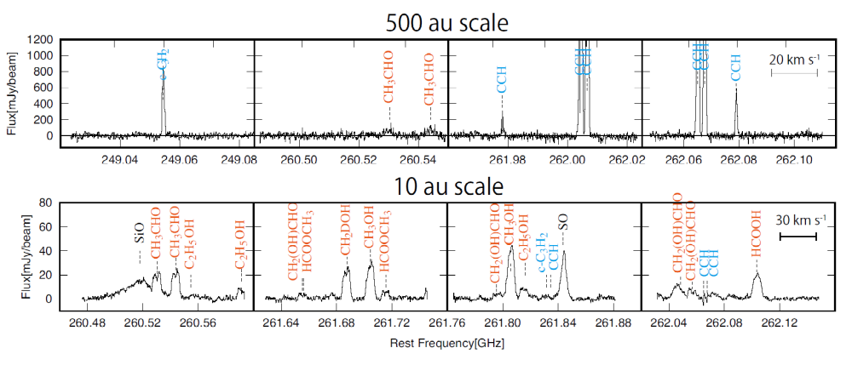
3. Hybrid: B335
Carbon-chains trace an extended component (WCCC).
COMs are in a compact component (hot corino chem.).
Imai et al. (2016, inprep.)

Slide 21
4. A Unified Picture
Chemical Change
Chemical Variation

Slide 22
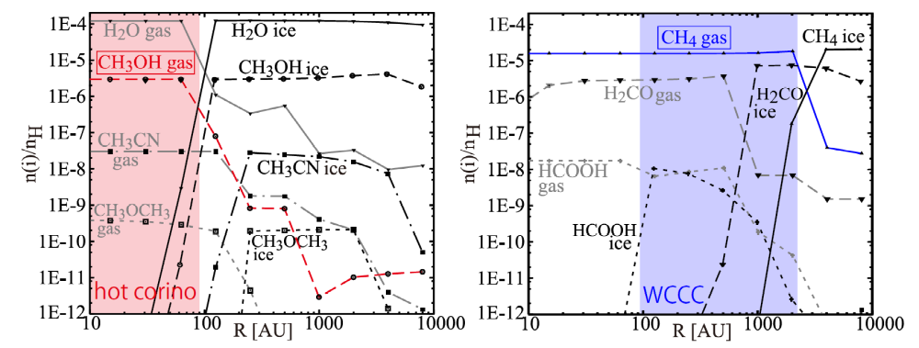
4. Origin of the Chemical Change
Chemical model of a collapsing core
  Evaporation of CH₄: T~25 K
  Evaporation of ice : T>100 K
L1527
Both are
occuring in
L483 & B335
IRAS 16293
Aikawa et al. Astrophys. J. 674, 993 (2008)

Slide 23
4. Origin of the Chemical Diversity
Hot Corino Source
H₂O, CH₃OH, COMs
H₂O, CH₃OH
COMs
H₂O, CH₃OH
COMs
Chemical Diversity of
Grain Mantle
CH₄
Carbon
Chains
H₂O, CH₃OH, COMs
CH₄
H₂O, CH₃OH
COMs
H₂O, CH₃OH
COMs
r ~ 1000 au
T ~ 25 K
r ~ 50 au
T ~ 100 K
★
WCCC Source
CH₄
Carbon
Chains
H₂O
CH₄
H₂O
H₂O

Slide 24
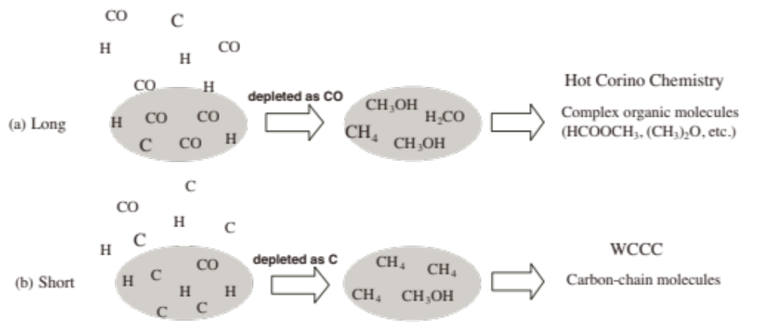
4. Origin of the Chemical Diversity
Duration Time Scale for the Starless-Core Phase
  Conversion of C to CO: τ_{chem} ~ 3 x 10⁵ yr
(e.g. Sakai & Yamamoto 2013)
  → Diversity of the chemistry on dust grains
(IRAS 16293 A&B)
Archetype?
Hybrid Chemistry
COMs and Carbon-chains
Intermediate
(L483, B335)
(L1527, TMC-1A)

Slide 25
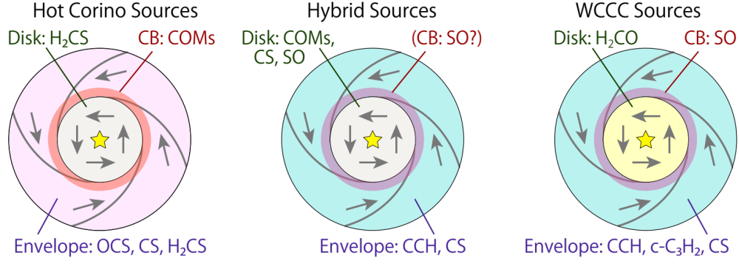
Summary: Chemistry at a few 10 au scale
Chemical change across the CB in each source
  → Chemical heritage from the envelope to the disk.
Chemical variation among sources
  Standard case?: Extended WCCC + Compact HC
e.g., IRAS 16293−2422
Source A & B
e.g., L483, B335
e.g., L1527, TMC-1A
IRAS 15398−3359

Slide 26
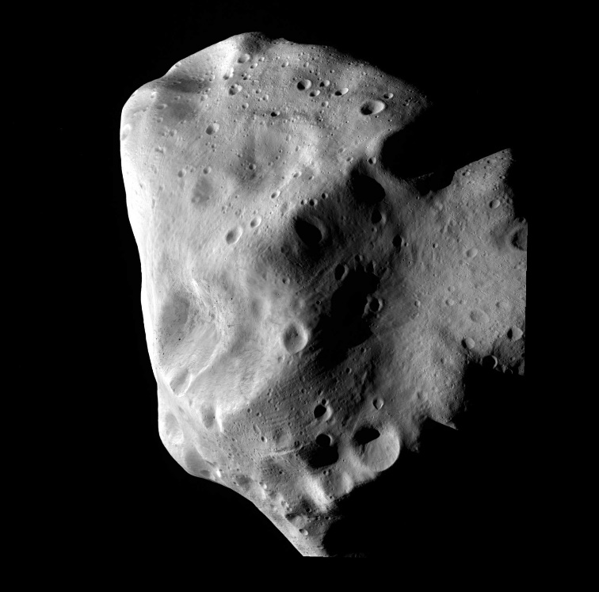
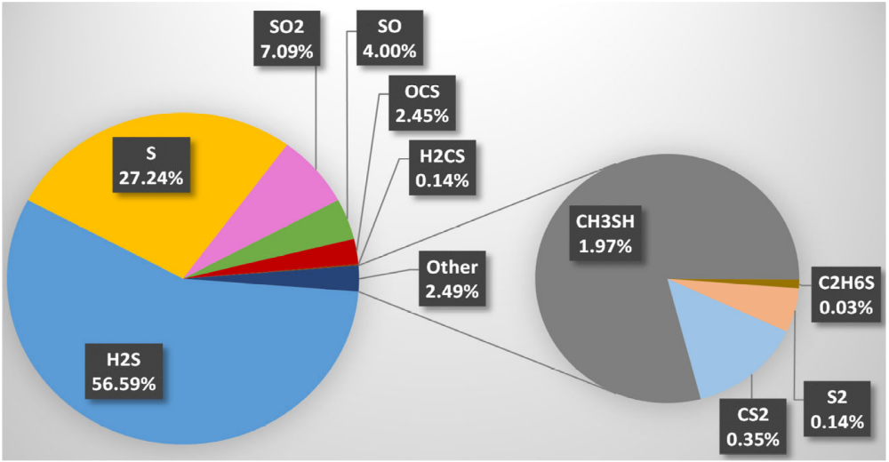
Future Prospects: Sulfur Case?
Rosetta mission: 67P/Churyumov-Gerasimenko
  http://www.esa.int/Our_Activities/Space_Science/Rosetta_overview
PILS: Drozdovskaya et al. (2018)
  Comparison with IRAS 16293−2422 Source B
Calmonte et al. 2016 MNRAS, 462, S253

Slide 27
Remaining Problems
1. What is occurring around the CB?
  Molecular processes
  Detailed structure of the transition zone
    See also the presentation by Nami Sakai (tomorrow)
2. What kinds of molecules are delivered into disks?
  Initial chemical condition of disks
3. What is the origin of the chemical diversity?
  Duration time: one possibility for carbon chemistry
  How about other species?
    e.g.) Sulfur chemistry

Slide 28
Timescales
7
Depleted mainly as CO
6
t_{chemical}
log (t [yr])
5
Depleted mainly as C
4
t_{free fall}
3
t_{depletion}
2
2
3
4
5
6
7
log (n [cm⁻³])

Slide 29
Carbon Chemistry around Low-Mass Protostars
20K: Evaporation of CO
  Source of C+ to produce various molecules
    CO + He⁺ → C⁺ + O + He
    C⁺ + H₂ → CH₂⁺ + hν (very slow: 10⁻¹⁶ cm³ s⁻¹)
25K: Evaporation of CH₄
  CH₄ can be a main destructor of C⁺ (if f(CH₄) > 10⁻⁷).
    CH₄ + C⁺ → C₂H₃⁺ + H (fast: 10⁻⁹ cm³ s⁻¹)
    C₂H₃⁺ + e → C₂H + H + H → ・・・
    (Carbon-Chain Production)
~100K: Evaporation of ice
  H₂O becomes the main destructor of C⁺.
    H₂O + C⁺ → CO⁺ + H₂
    (Evaporation of Saturated Organic Molecules)

