Slide 1
Models of Star-Forming Filaments
Phil Myers
Harvard-Smithsonian CfA
Early Phase of Star Formation 2016 • Ringberg Castle, Germany • June 27, 2016

Slide 2
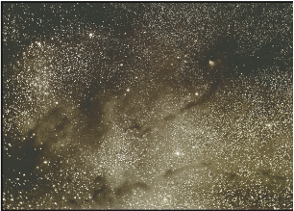
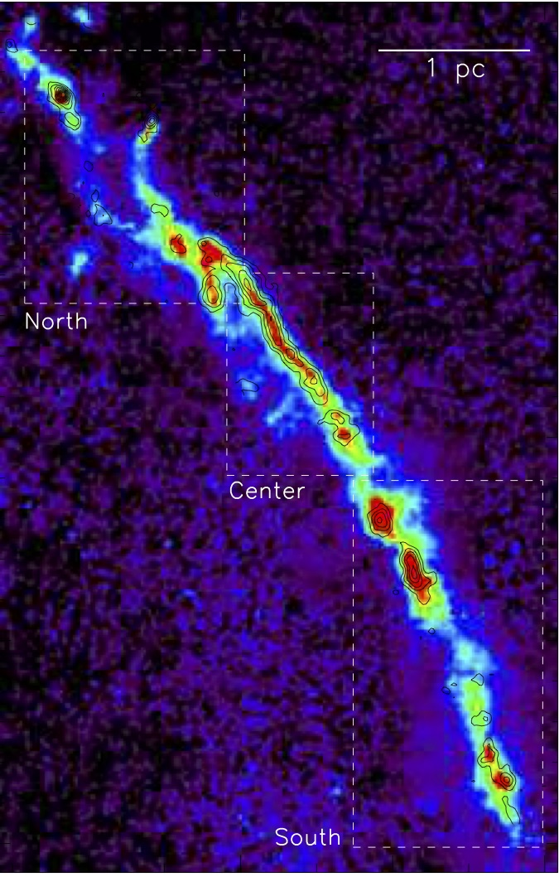
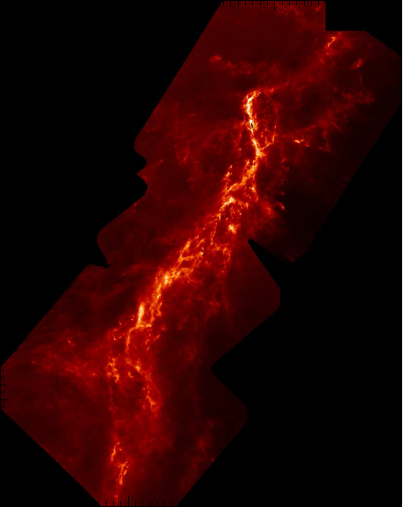
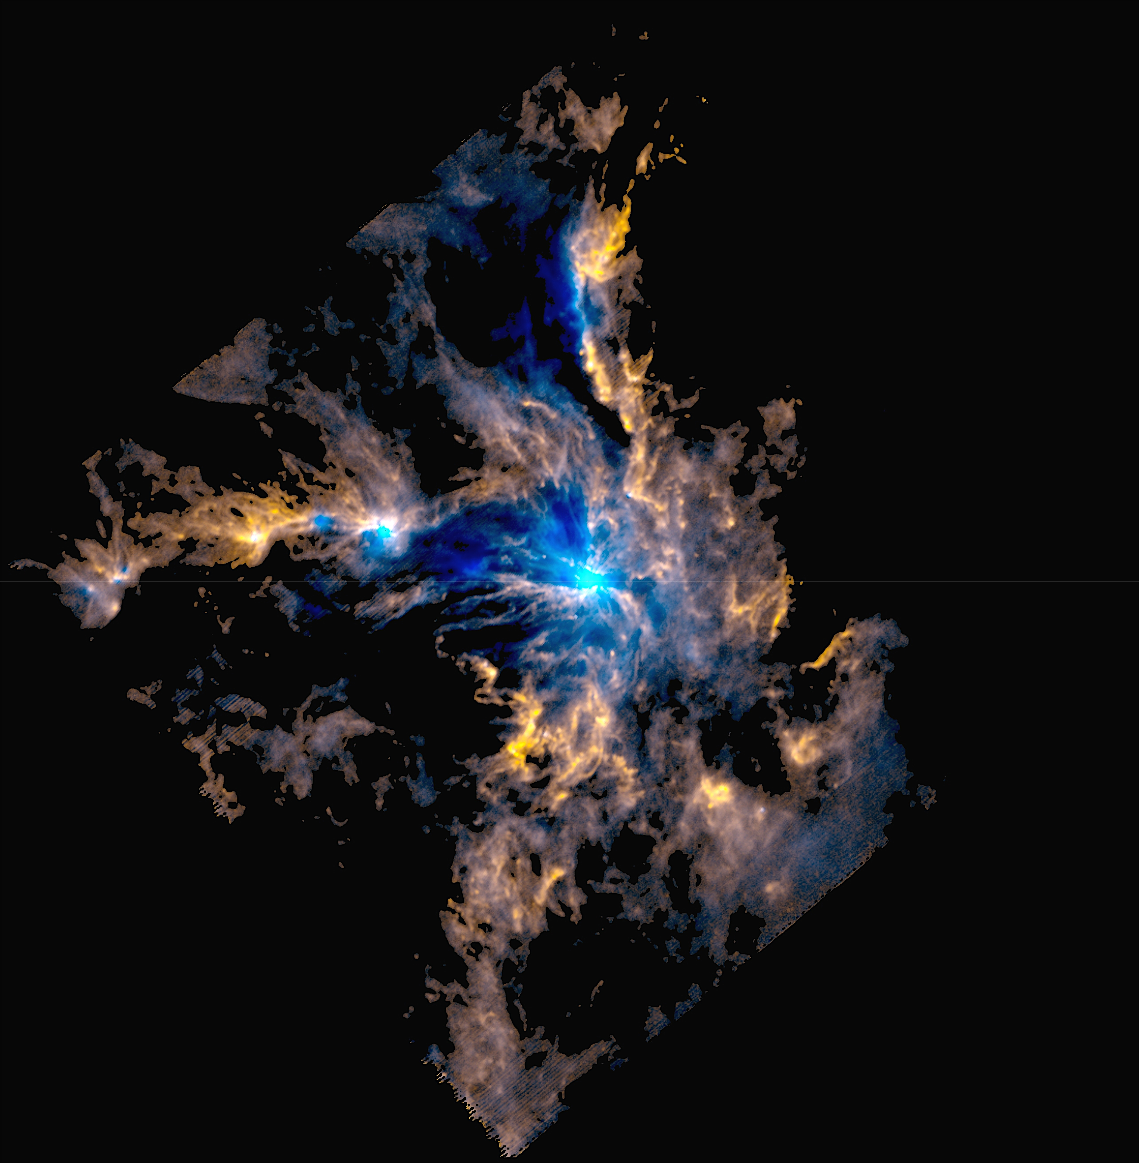
Overview
Understanding how filaments make stars
simple 2D models n(r, z) address filament M, L, cores, N-pdfs, SFE
match observed shapes fils w no cores, low-mass cores, cluster-cores
match observed properties mean radial profile, pole-free N-pdf
star-forming potential N(stars) ≲ N(M_{J}) in dense gas
5 pc
Taurus complex Barnard 07
Musca Kainulainen+15
Orion A Stutz+ 15
Mon R2 Pokhrel+ 16

Slide 3
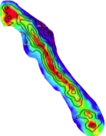
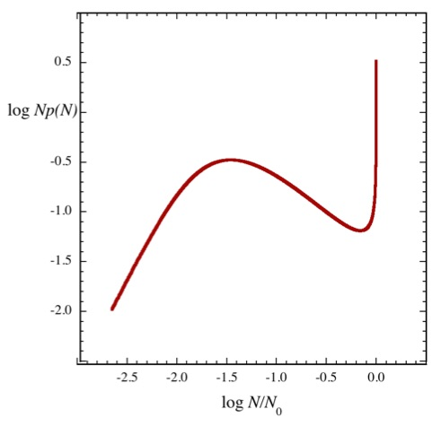
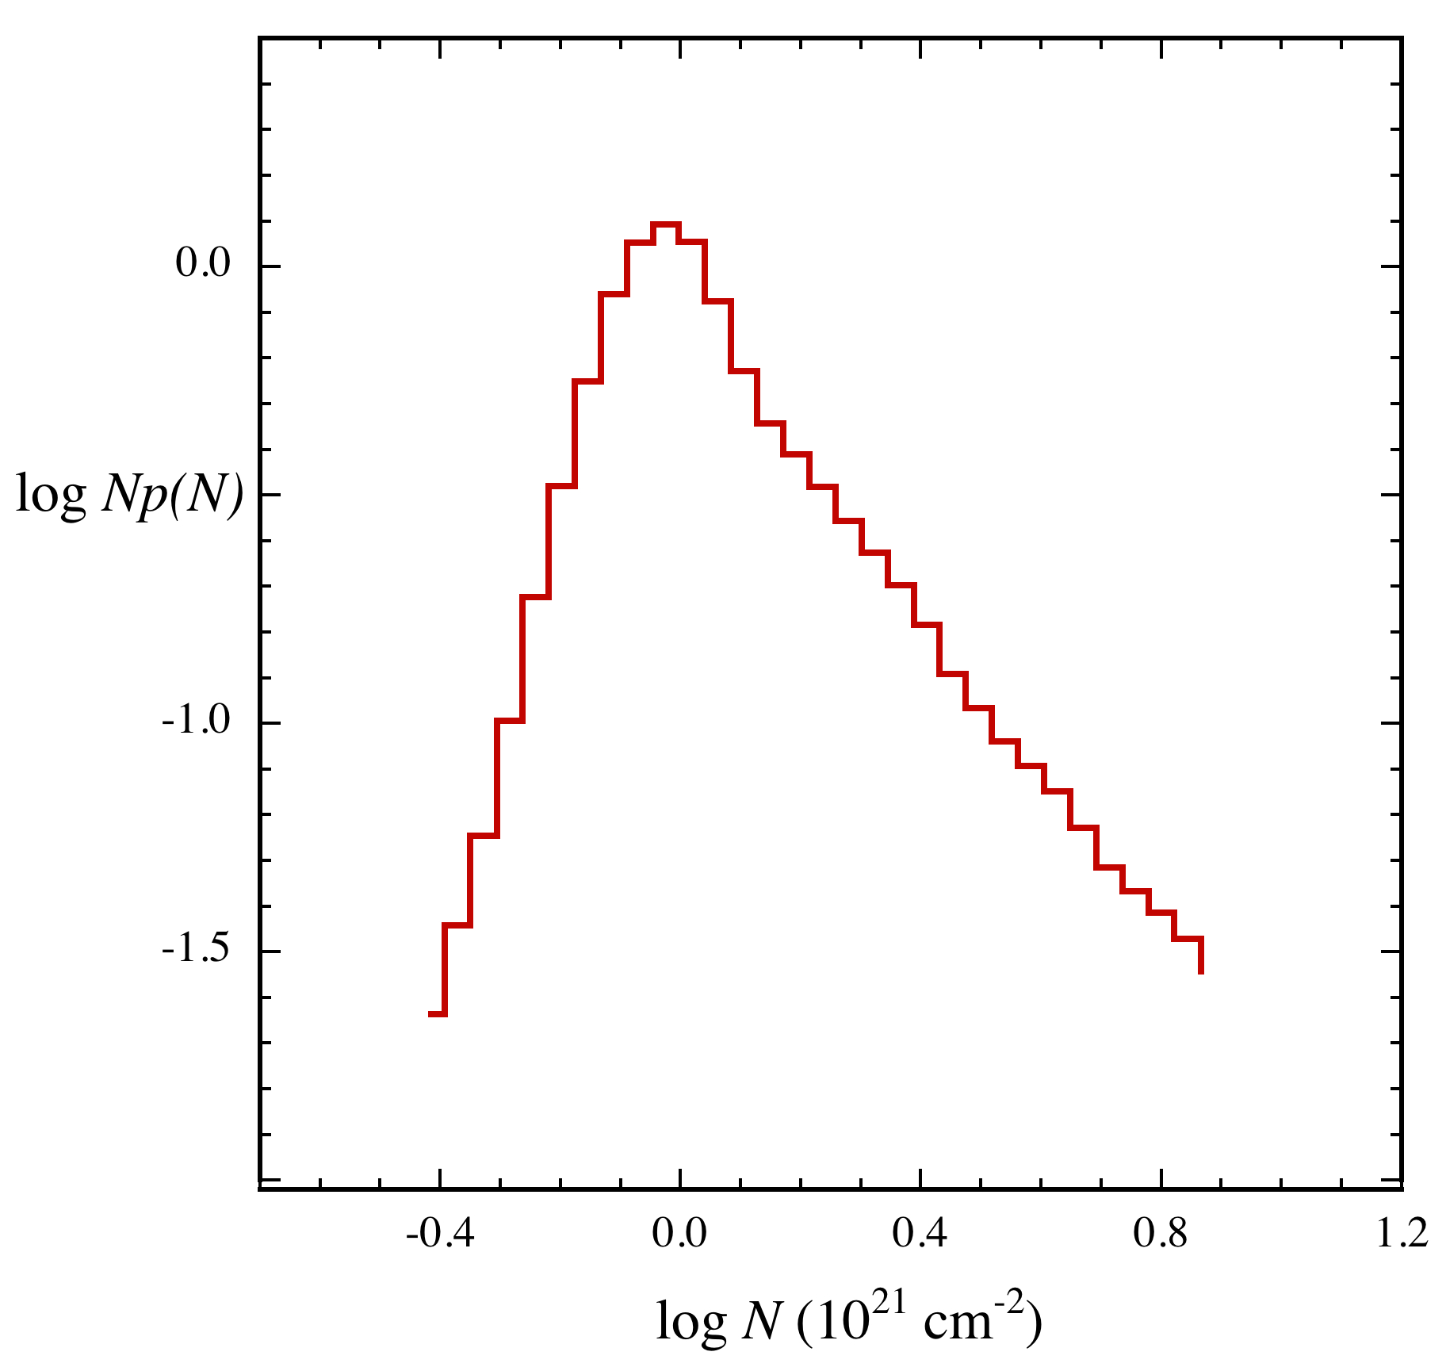
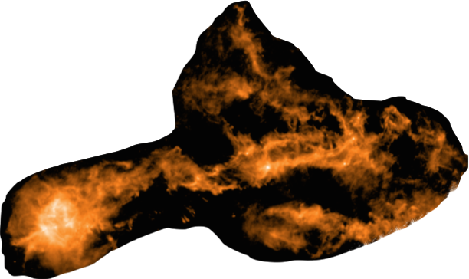
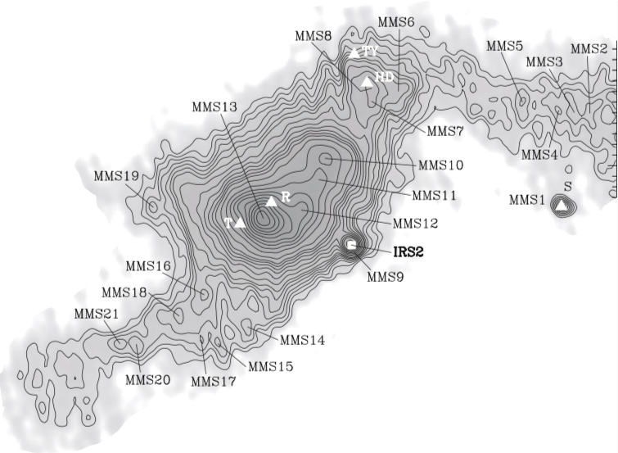
1D and 2D structural models
1D models
n = n(r) dynamical evolution of self-gravitating cylinders (Arzoumanian+ 11, André+14)
Questions what sets filament L and M, lumpy structure?
how does filament structure relate to N-pdfs?
what sets the SFE of a filamentary cloud?
Musca Kainulainen+15
Plummer cyl N-pdf
observed N-pdf
log
Np(N)
pole
no
pole
Fischera 14
IC5146 Schneider et al. 2016
log N
log N
YSOs in CrA
Chini+ 03, Peterson+ 11
Next 2D axisymmetric models n = n(r, |z|)

Slide 4
Axisymmetric filament models
density equations
Plummer Cyl
Trunc Plum Cyl
Trunc Plum-
Plum Cyl
Trunc Pro Sph
Stretched
Trunc Pro Sph

Slide 5

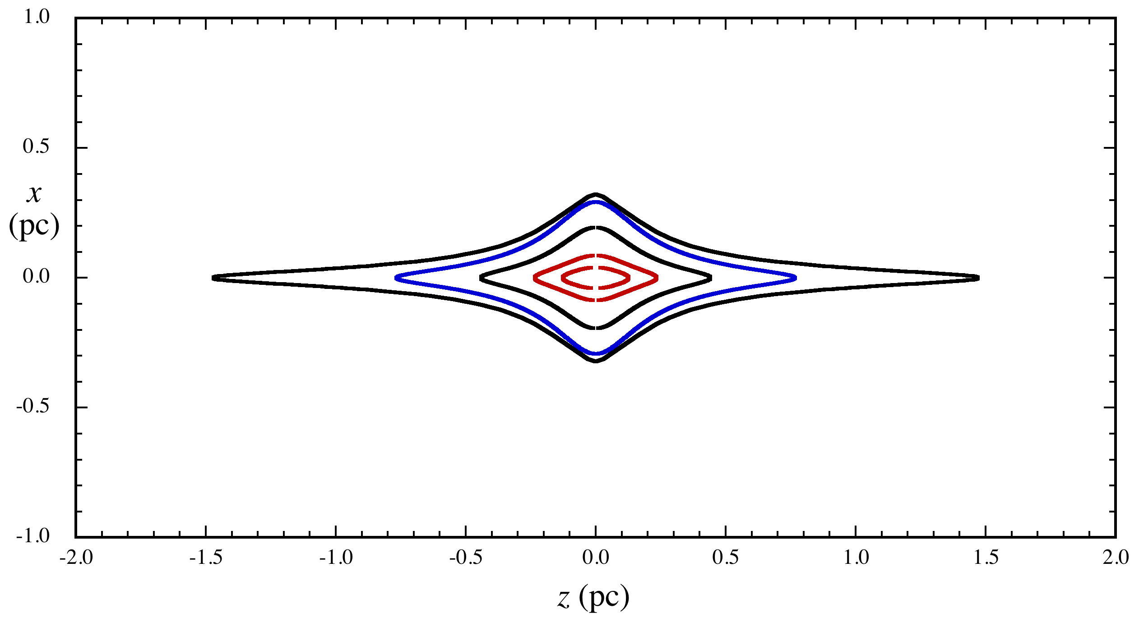
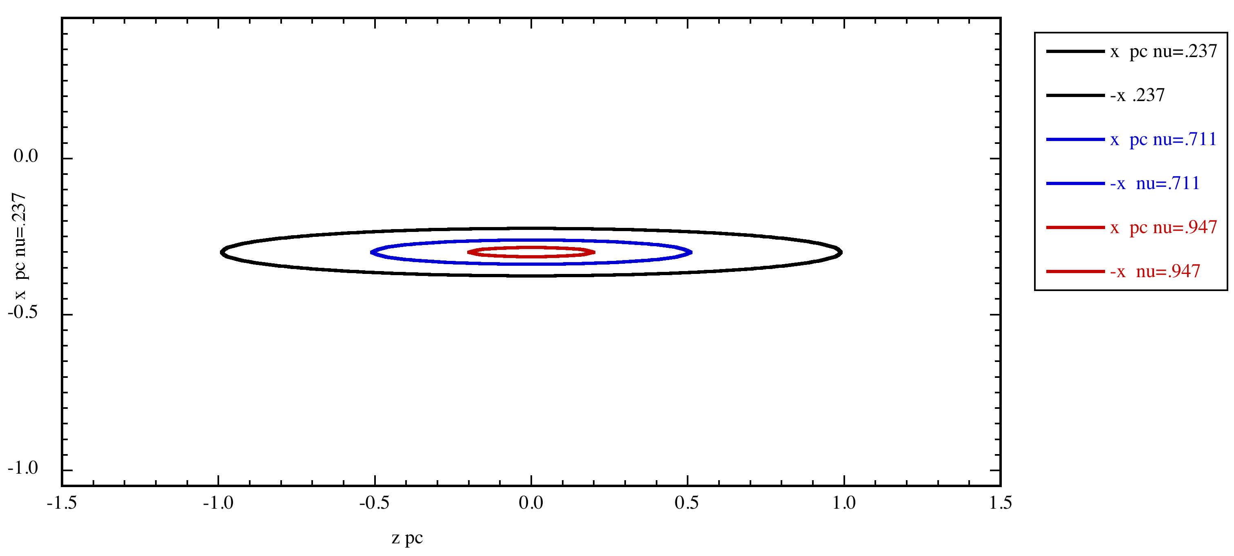
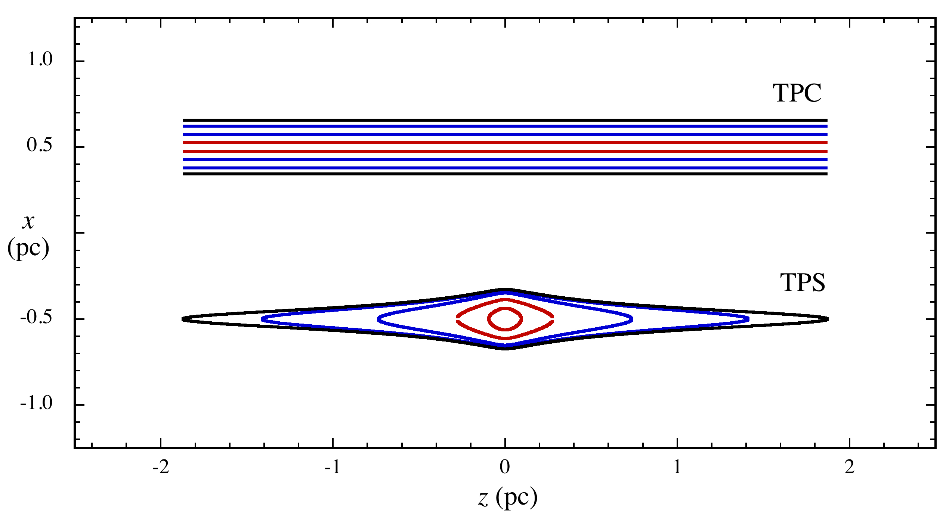
Axisymmetric filament models
density equations
Plummer Cyl
Trunc Plum Cyl
Trunc Plum-
Plum Cyl
Trunc Pro Sph
Stretched
Trunc Pro Sph
column density images
PC, TPC Plummer cyl
TPPC filamentary cluster-core
TPS slightly concentrated fil
STPS filamentary low-mass core

Slide 6
1D and 2D model comparison
1D 2D
truncation radial, ≤ ∞ radial < ∞ & axial < ∞
parameters n₀, r₀, p, r_{max} n₀, r₀, p, r_{max}, a
L and M undefined finite
axial structure uniform centrally condensed
N-pdf pole no pole
gravitational polytrope dep. p no eq., maybe flow
equilibrium Toci & Galli 15 Vazquez-Semadeni 15
2D models describe more filament properties than 1D models, with one added parameter a or a_{2.}
They can not describe fibers (Hacar+ 13), networks (Pokhrel+16), low-N B environment (Planck XXXV)
Next: 2D models match observed N-profiles

Slide 7
2D models: N- profiles resemble Plummer N-profiles
Each 2D model has n ~ r ⁻² → N-profile has p ≈ 2 shape as in PC N-profile
x
TPS
PC
z

Slide 8
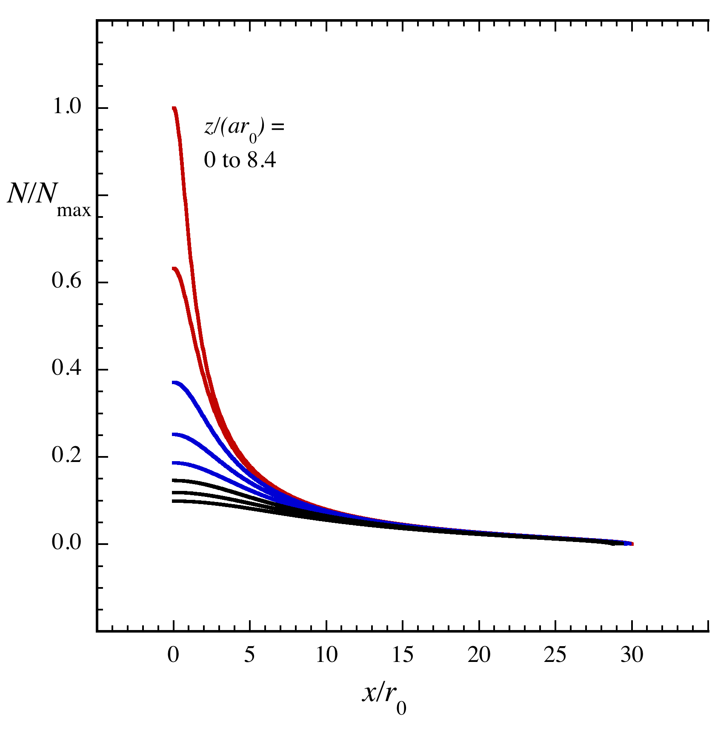
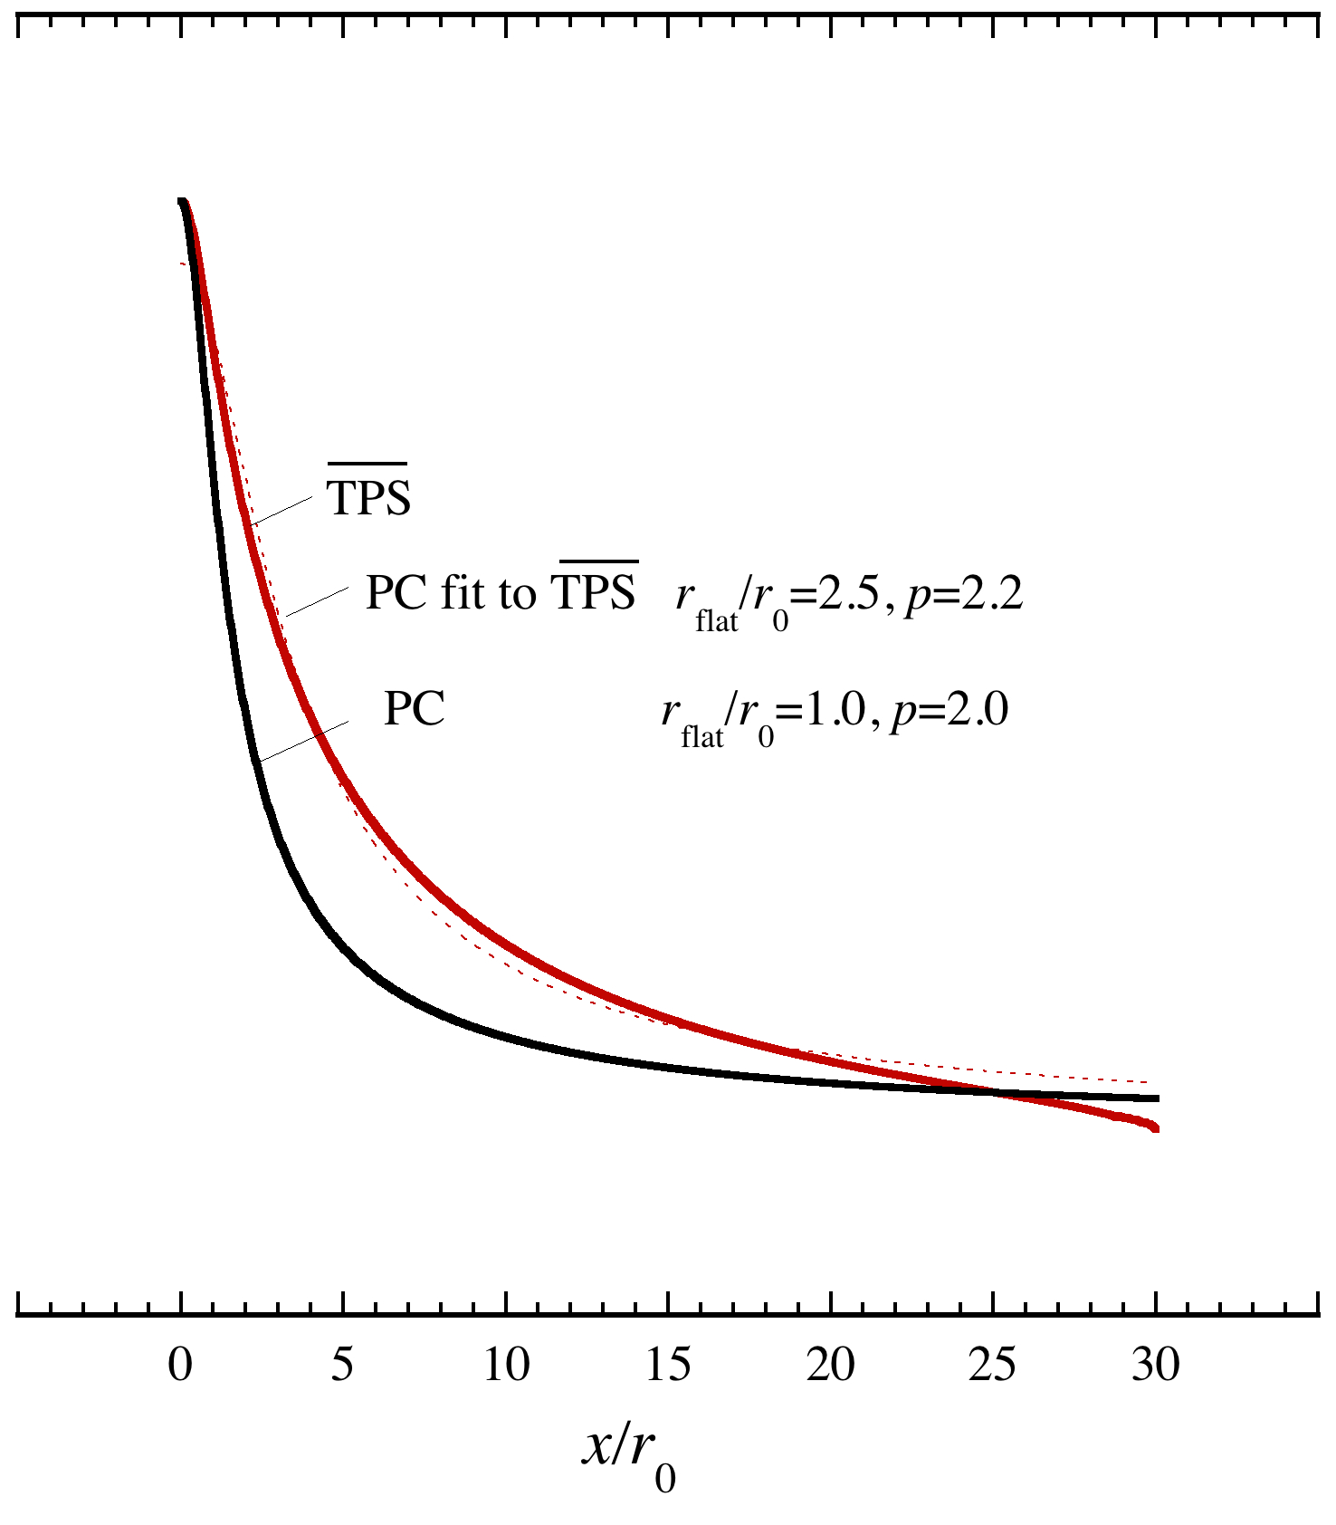
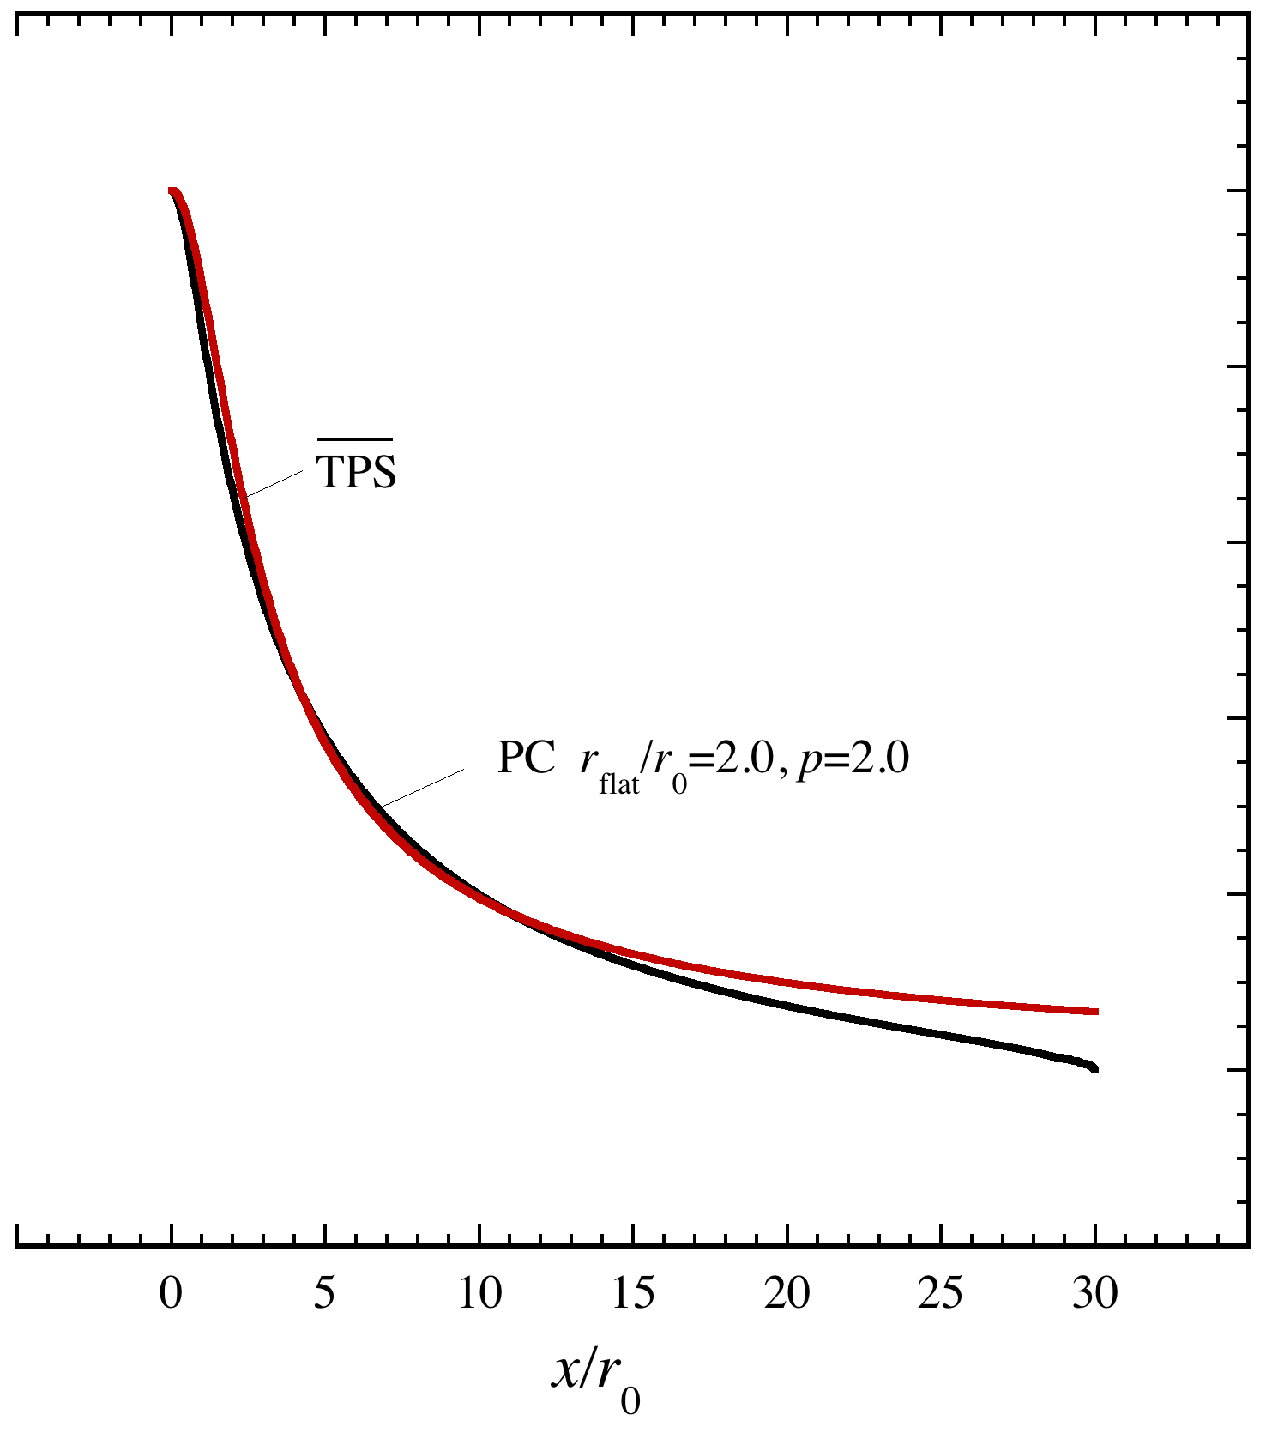
2D models: N- profiles resemble Plummer N-profiles
Each 2D model has n ~ r ⁻² → N-profile has p ≈ 2 shape as in PC N-profile
x
TPS
PC
z
TPS N(x) at z_{i}
TPS N(x) and PC N(x)
TPS N(x) and PC N(x)
if r₀(TPS)=r₀(PC):
TPS broader, same p
if r₀(TPS)=r₀(PC)/2:
same width, same p
Next: 2D models match observed N-pdfs

Slide 9
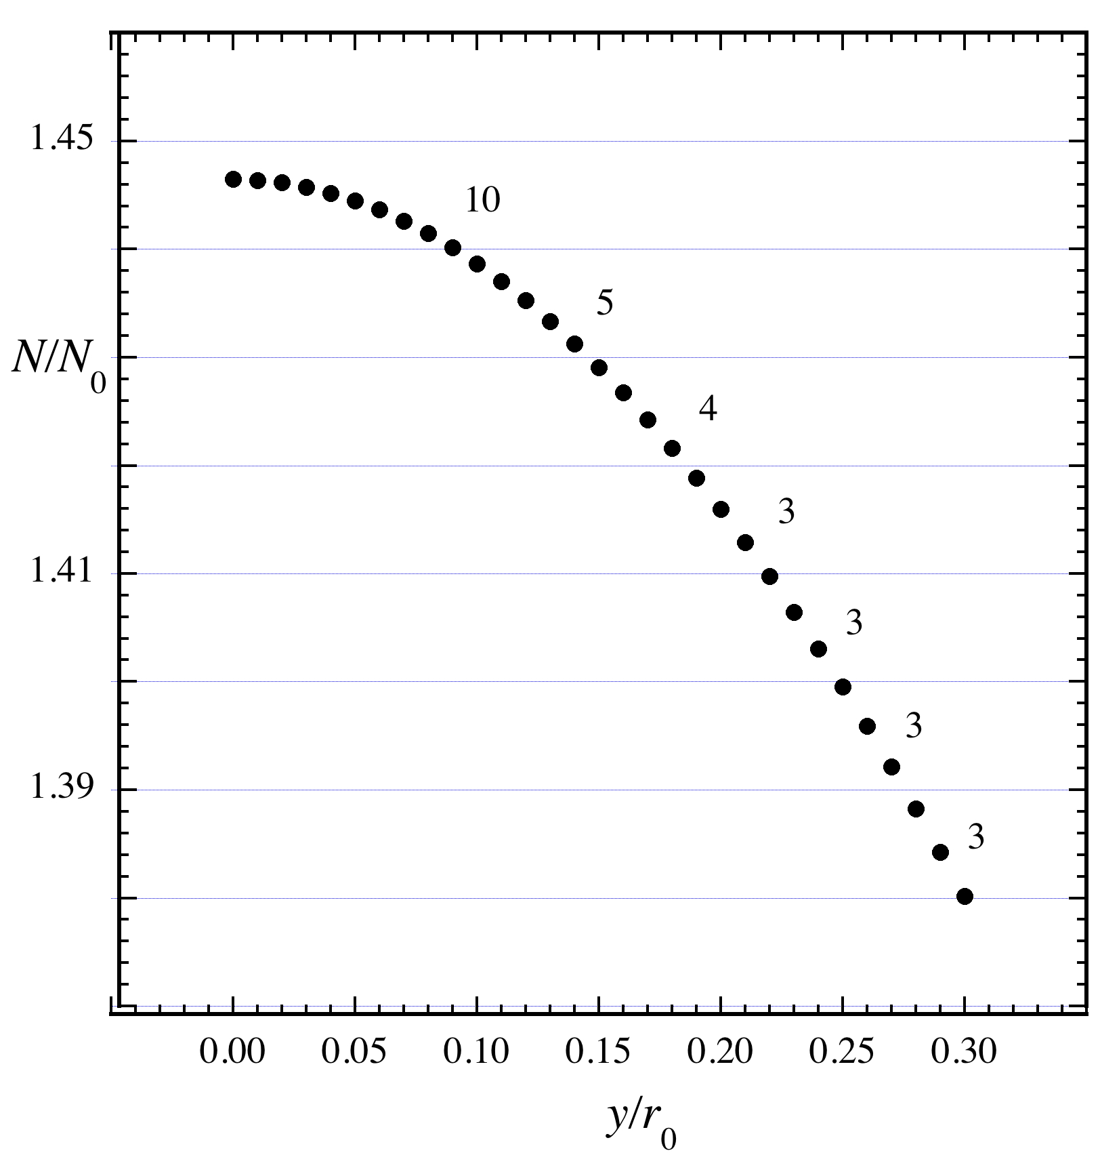

2D models: N-pdfs can be pole-free, 1D models cannot
N-profile
pole in p(N)
N-pdf = Np(N)
1D PC, TPC
axially uniform
every slice has same N₀
log
Np(N)
N(b)
pole
Plummer
cyl p=2
Fischera 14
proj. radius b
log N

Slide 10
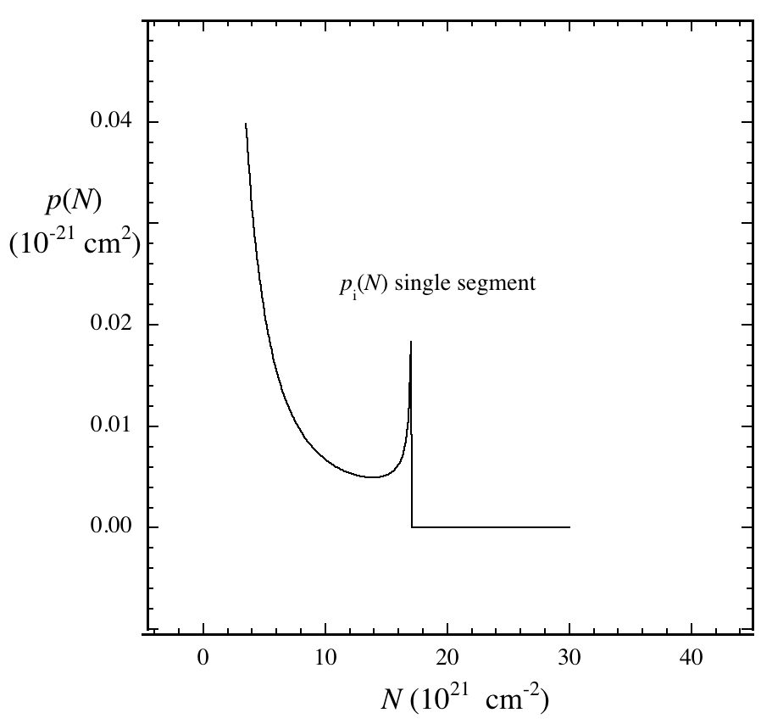
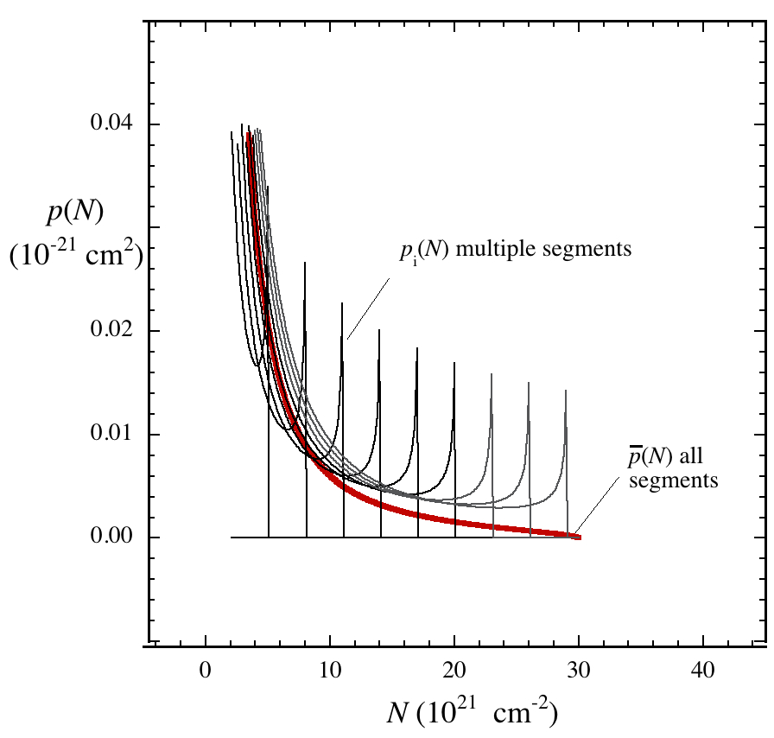
2D models: N-pdfs can be pole-free, 1D models cannot
N-profile
pole in p(N)
N-pdf = Np(N)
1D PC, TPC
axially uniform
every slice has same N₀
log
Np(N)
N(b)
pole
Plummer
cyl p=2
Fischera 14
proj. radius b
log N
2D TPS, STPS, TPPC
axially nonuniform
~ same N₀ pole
different N₀ no pole
p(N) one slice
p(N), p(N), many slices
poles
average
away
pole
at N₀
Statistical ensembles of 1D models can also suppress poles (Fischera 14) Next: fitting models to obs

Slide 11
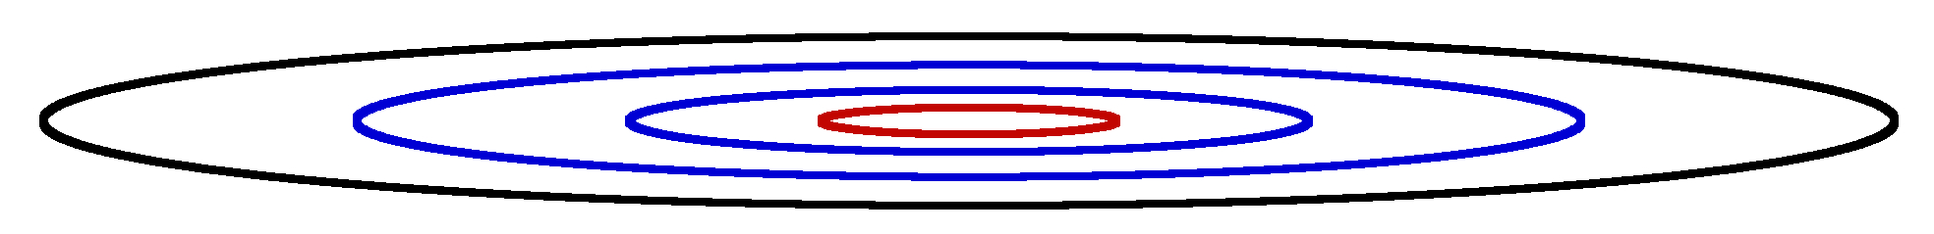
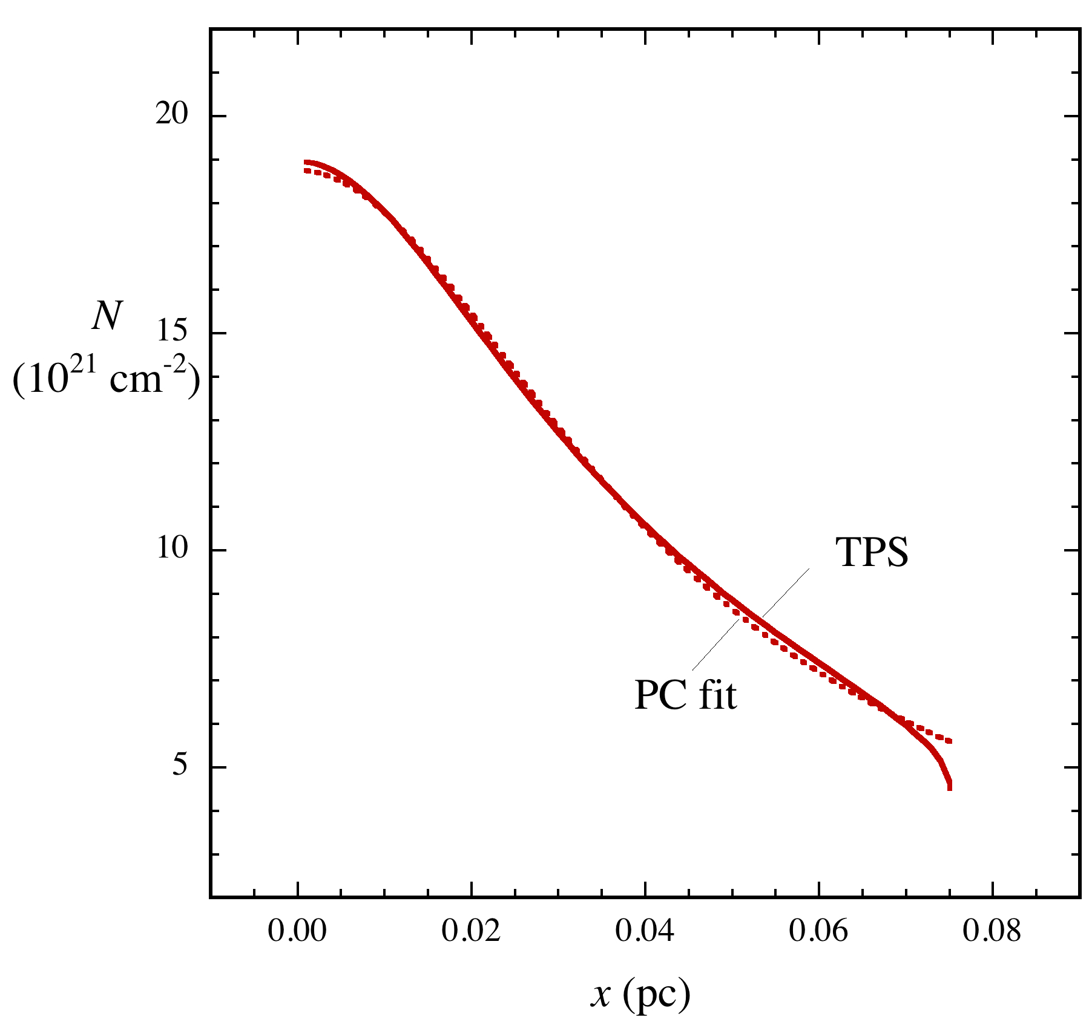
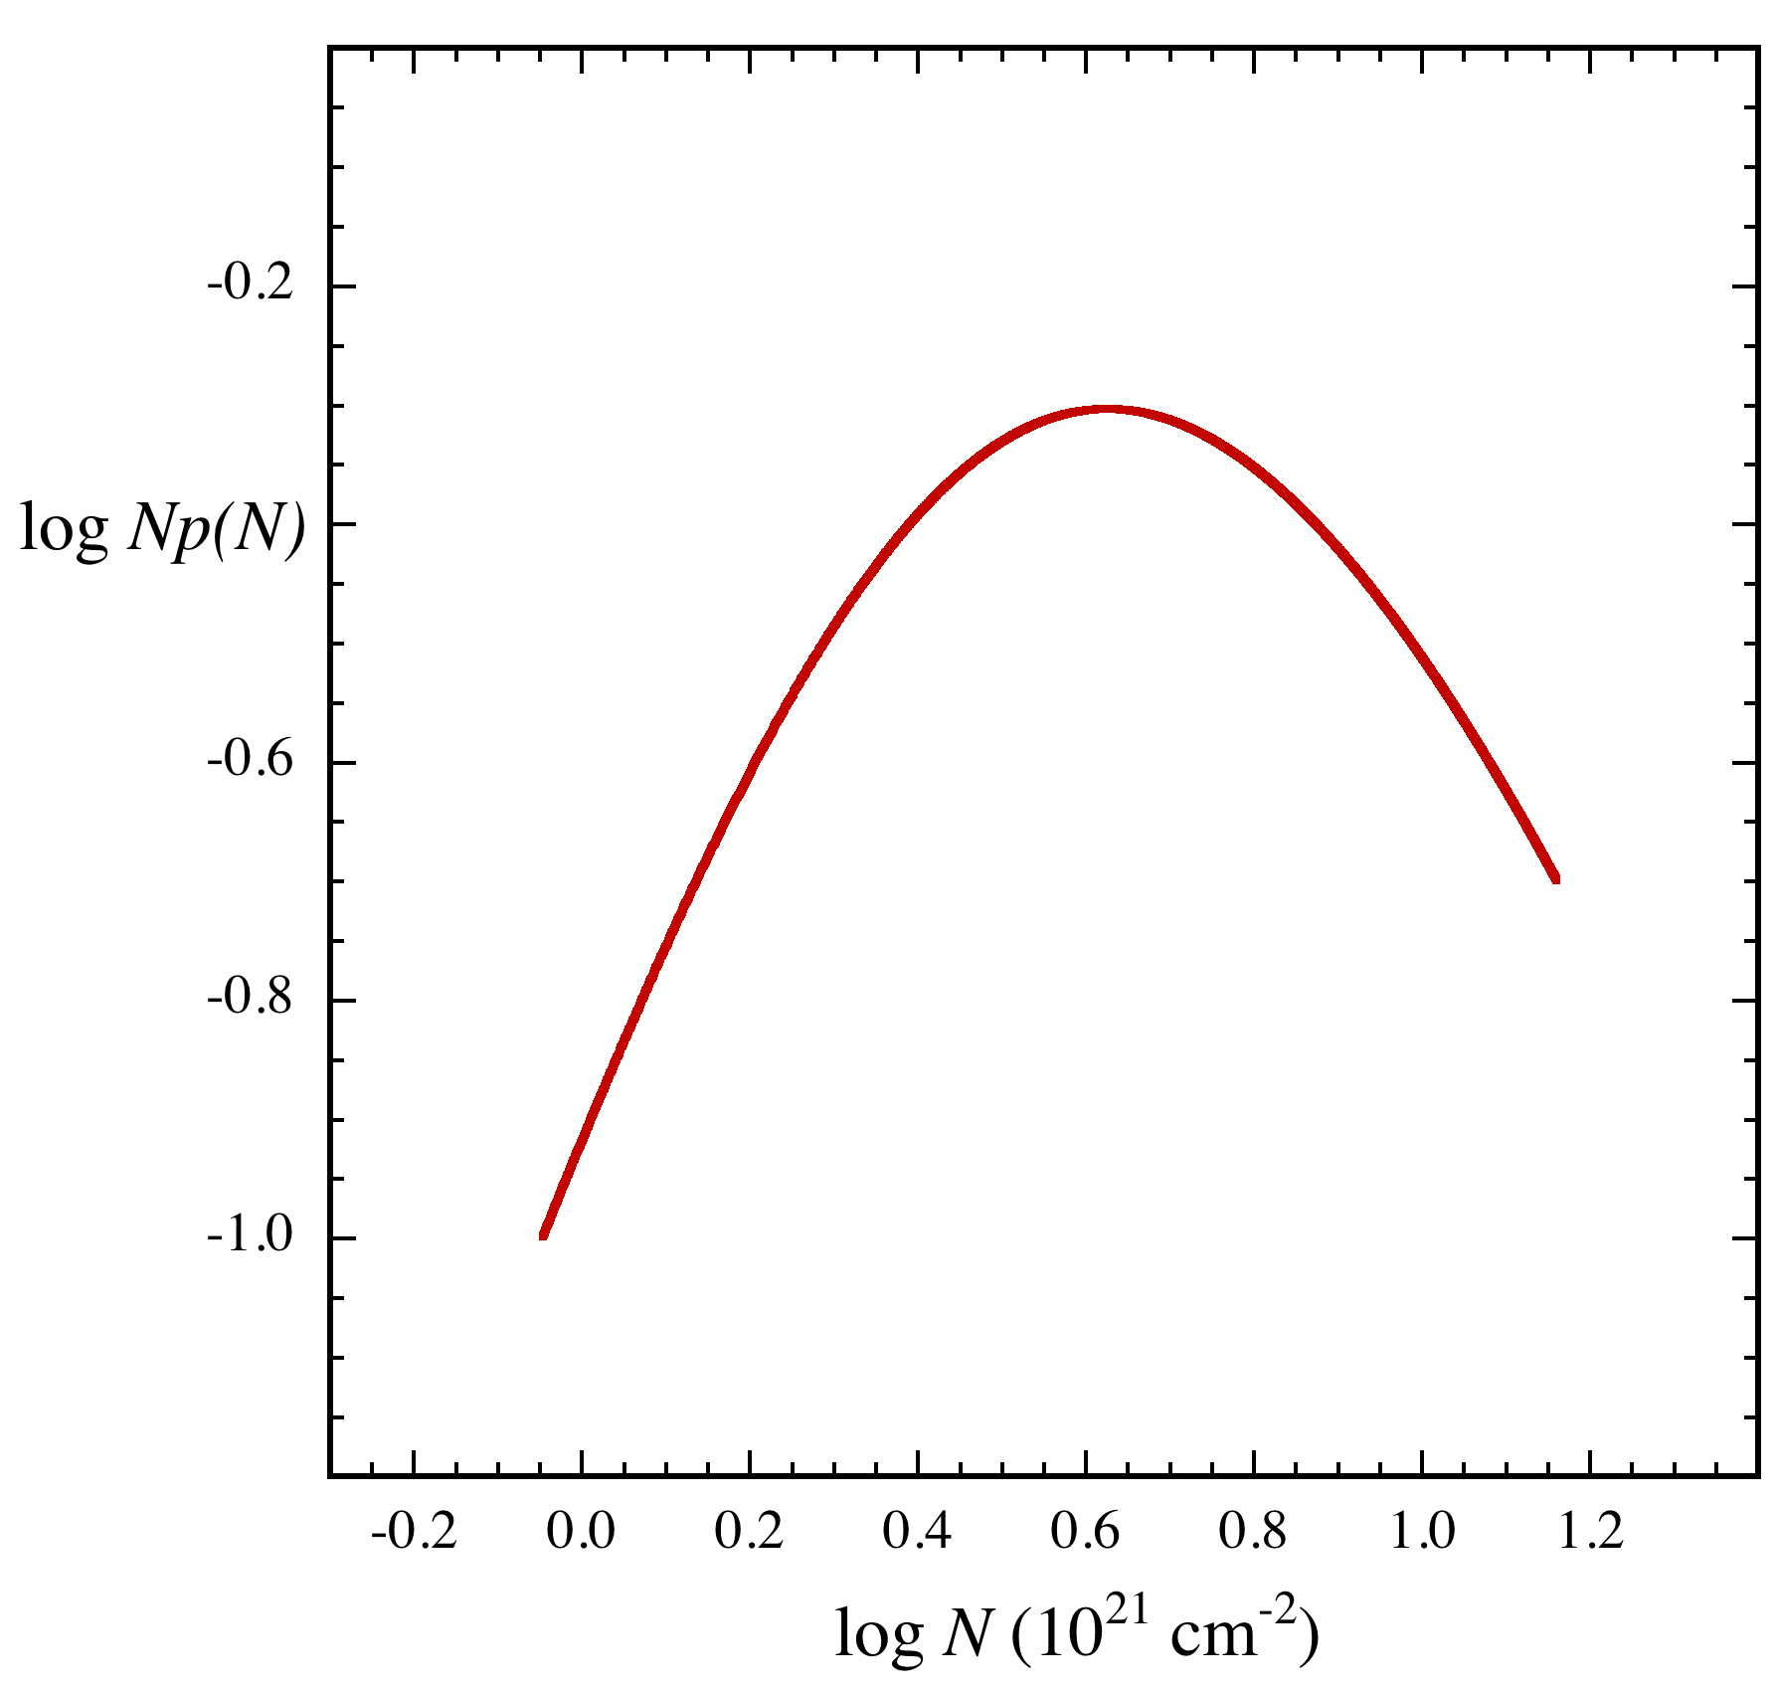
Fitting 2D models to observations
Musca central region
Kainulainen+ 15
0.5 pc
observed L, R, and N(x) set TPS parameters R = 0.075 pc L = 1.6 pc r₀ = 0.027 pc n₀ = 7.1 10⁴ cm⁻³
x
TPS model: both
n(r, z) and N(x, z)
z
N-contours N = 4.5 – 17 10²¹ cm⁻²
N-profile, PC fit
pole-free N-pdf
analytic expressions for N-contours, N-profile, N-pdf allow easy evaluation Next: predicting N_{stars}

Slide 12
2D models predict N_{stars}
Basic idea N_{stars} ≲ N_{Jeans} in gas with n > n_{min} modified Jeans fragmentation
Defining the Jeans mass
m_{IMF}
Typical new star has final mass = 0.36 M⨀ (Weidner & Kroupa 06)
“IMF-BE sphere” forms m_{BE} = /ε = 1 M⨀ (ε = 0.35 Alves+ 10, Könyves+ 15)
core 10 K
IRDC 20 K
cluster >20 K
m_{IMF}
m_{IMF}

Slide 13
2D models predict N_{stars}
Basic idea N_{stars} ≲ N_{Jeans} in gas with n > n_{min} modified Jeans fragmentation
Defining the Jeans mass
m_{IMF}
Typical new star has final mass = 0.36 M⨀ (Weidner & Kroupa 06)
“IMF-BE sphere” forms m_{BE} = /ε = 1 M⨀ (ε = 0.35 Alves+ 10, Könyves+ 15)
core 10 K
IRDC 20 K
cluster >20 K
m_{IMF}
m_{IMF}
Counting Jeans masses
IMF-BE sphere has associated volume V_{BE}
(2r_{BE})³ ≤ V_{BE} ≤ (λ _{J})³
Star-forming zone n > n_{BE,min}, r >r_{BE} has volume V_{SFZ}
dense enough
to host BEs
Number of stars N_{stars} ≲ N_{Jeans} = volume ratio V_{SFZ} /V_{BE}
SFZ
Next: apply to Musca

Slide 14
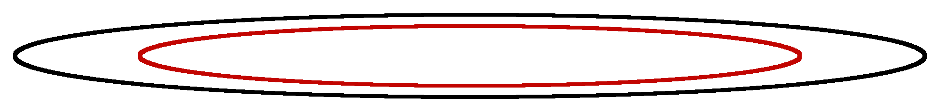
N_{stars} in the Musca filament
0.5 pc
Musca central region
Kainulainen+ 15 T = 10 K
Star-forming
zone
SFZ: TPS gas with enough n, r to
harbor BEs n > n_{BE,min}, r > r_{BE}
SFZ

Slide 15
N_{stars} in the Musca filament
0.5 pc
Musca central region
Kainulainen+ 15 T = 10 K
Star-forming
zone
SFZ: TPS gas with enough n, r to
harbor BEs n > n_{BE,min}, r > r_{BE}
SFZ
N_{Jeans}
volume ratio N_{Jeans} = 3-4

Slide 16
N_{stars} in the Musca filament
0.5 pc
Musca central region
Kainulainen+ 15 T = 10 K
Star-forming
zone
SFZ: TPS gas with enough n, r to
harbor BEs n > n_{BE,min}, r > r_{BE}
SFZ
N_{Jeans}
volume ratio N_{Jeans} = 3-4
N_{cores}
core chain B213 Tafalla & Hacar 15
N_{stars} ≲ N_{Jeans} = 3-4, similar to the chain of cores in B213
Next: apply to Coronet

Slide 17
N_{stars} in the Coronet filament
R CrA MMS13
Chini+ 03, Alves+ 14,
T = 20 K
N = 3 to 90 10²¹ cm⁻²
Coronet: 8 I’s
5 older YSOs
Peterson+ 11
0.3 pc

Slide 18
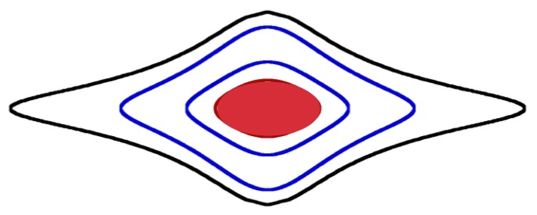
N_{stars} in the Coronet filament
R CrA MMS13
Chini+ 03, Alves+ 14,
T = 20 K
N = 3 to 90 10²¹ cm⁻²
Coronet: 8 I’s
5 older YSOs
Peterson+ 11
0.3 pc
SFZ
TPPS fil model
r₀ = 0.036 pc n₀ = 3 10⁵ cm⁻³
Jeans mass
r_{BE} = 0.025 pc n_{BE,min} = 1 10⁵ cm⁻³
N_{Jeans} = 3-8
N = 1 to 50 10²¹ cm⁻²
BES
N_{stars} ≲ N_{Jeans} = 3-8 ≈ N(class Is) SFZ size ≈ Coronet size

Slide 19
Caveats and applications
Caveats
not all filaments have such simple structure
Jeans estimate = static model of a dynamic process
no v, no B, no feedback from young stars
Applications
compare already formed differentiate “young” and
and predicted N_{stars} “old” core-fil systems
use model clouds as initial differentiate “slow” and “fast”
states for simulations star-forming evolution

Slide 20
Summary
Understanding how filaments make stars
simple models address filament M, L, cores, N-pdfs, SFE
2D axisym models mod Plummer cylinder, Plummer spheroid
match observed shapes fils w no cores, low-mass cores, cluster-cores
match observed properties mean radial profile, pole-free N-pdf
star-forming potential N(future stars) ≲ N(M_{J}) in dense gas
5 pc
Taurus complex Barnard 07
Musca Kainulainen+15
Orion A Stutz+ 15
Mon R2 Pokhrel+ 16

