Slide 1
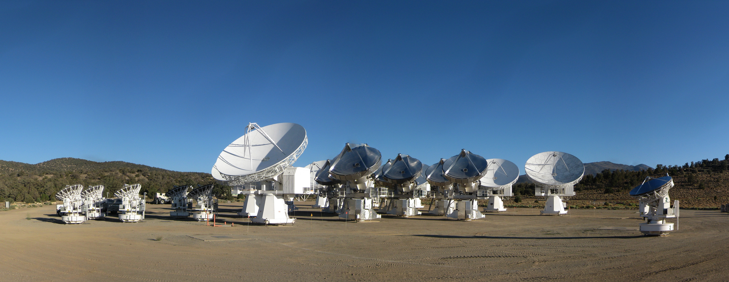
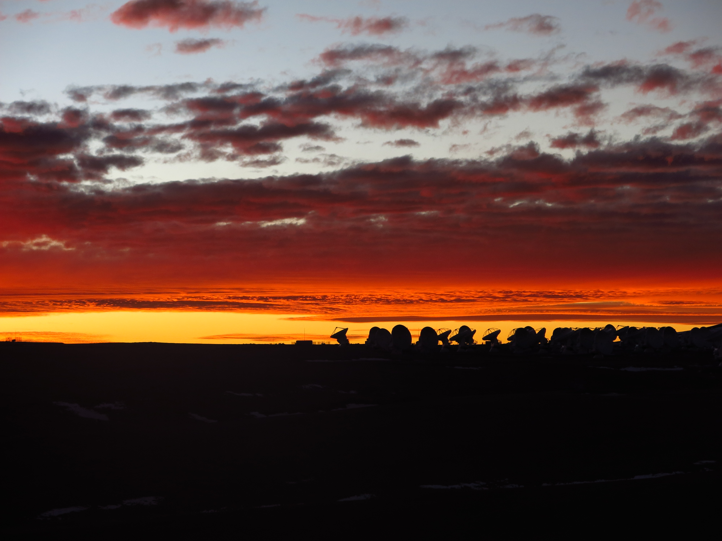
The first polarization results from ALMA: filaments, disks, dust polarization, and scattering
Credit: Chat Hull (Harvard/NRAO)
Photo credit: C. Hull
Chat Hull
Jansky Fellow —
Harvard-Smithsonian Center for Astrophysics
National Radio Astronomy Observatory
30 June 2016
Focus Group 2: Magnetic fields & polarization in YSOs
Early Phases of Star Formation
Ringberg Castle, Tegernsee, Germany

Slide 2
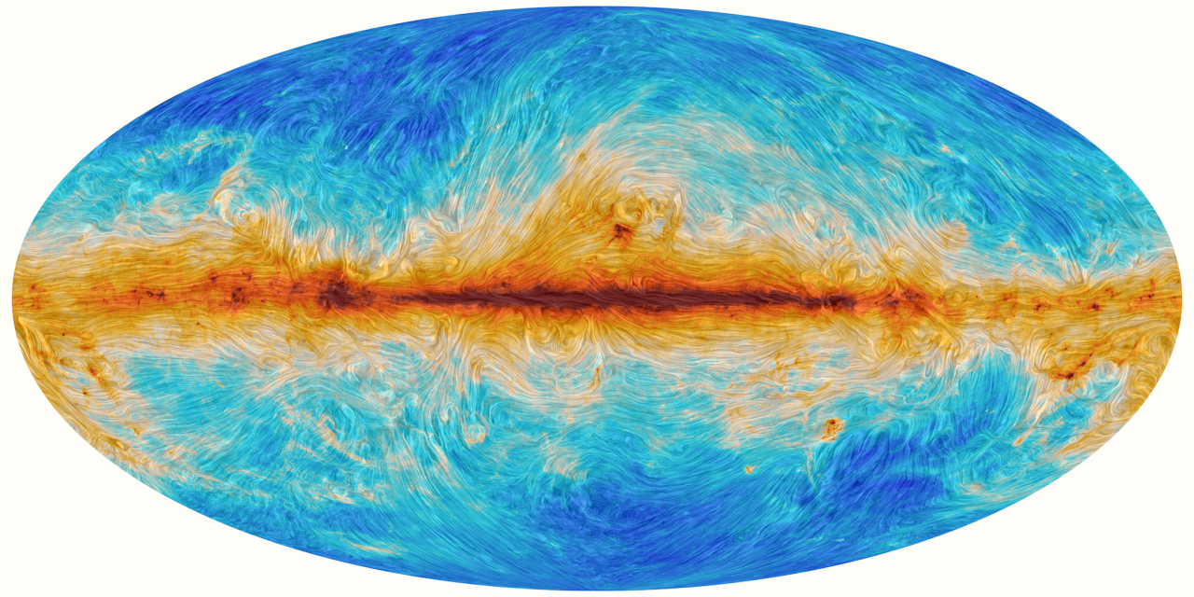
B-fields at large scales
20 pc
Scaled to nearby SFRs
Planck Collaboration
planckandthemagneticfield.info

Slide 3
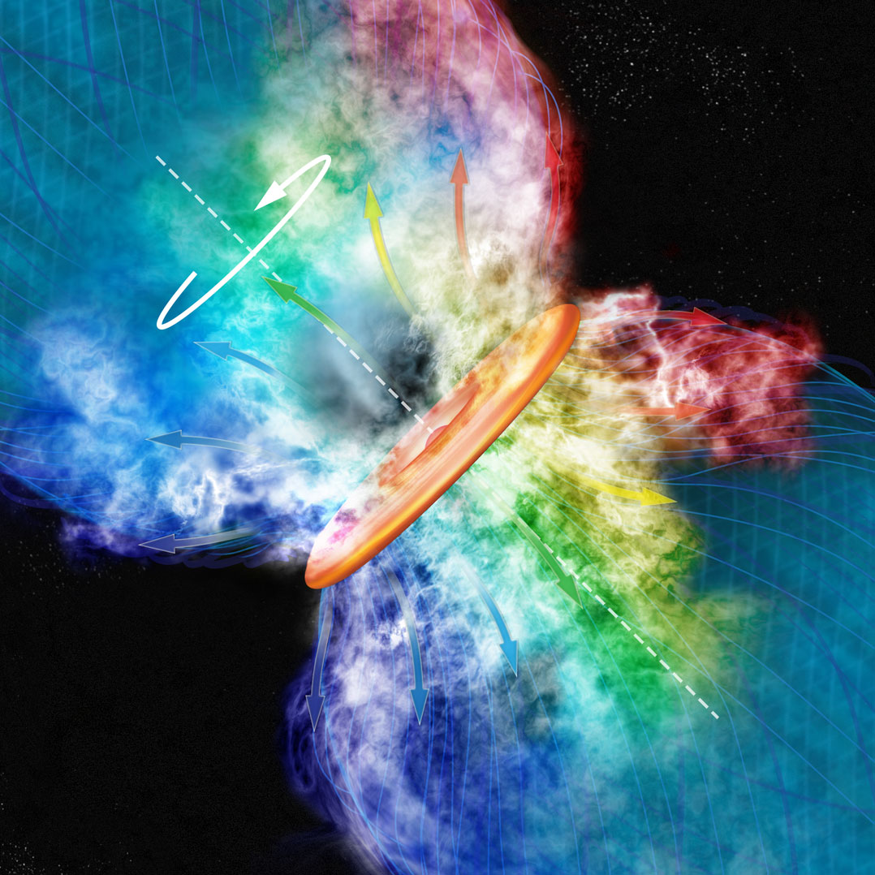
Credit: Bill Saxton, NRAO/AUI
KALYPSO project, Harvard/CfA

Slide 4
Magnetized protostellar envelopes

Slide 5
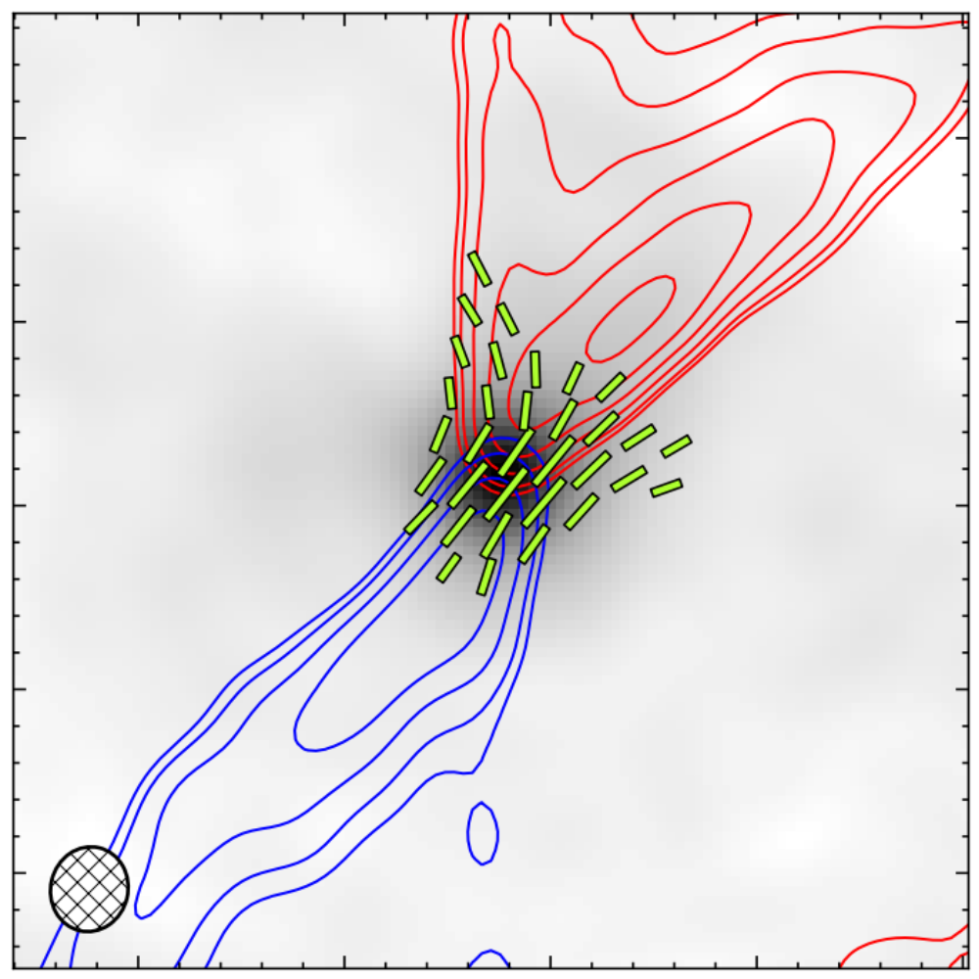
TADPOL results
1000 AU
L1157
Hull+2014, ApJS, 213, 153
See also: Stephens+ (incl. C.H.) 2013, ApJL, 769, L15
Notes:
NEARBY SF regions:
-Perseus (NGC 1333, L1448, SVS13): 235 pc (masers in SVS13) → 03:30 LST
-Taurus (DG Tau, L1527): 140 pc → 04:30 LST
-Orion: 400 pc → 05:30 LST
-Serpens: 415 pc → 18:30 LST
-Ophiuchus: 140 pc → 17:00 LST
-Cepheus (L1157): 250 pc → 22:00 LST
-Isolated (B335, Bok globule): 250 pc

Slide 6
Credit: Bill Saxton, NRAO/AUI
KALYPSO project, Harvard/CfA

Slide 7
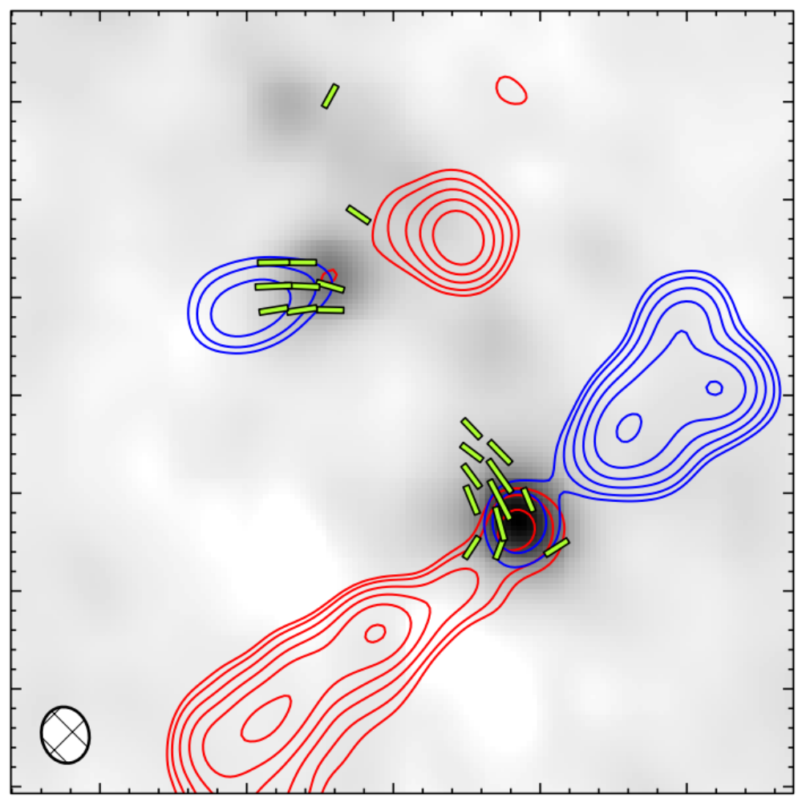
TADPOL results
Ser-emb 8, 8(N)
1000 AU
B-fields and outflows are randomly aligned on 1000 AU scales
What about 100 AU?
Hull+2014, ApJS, 213, 153
Notes:
NEARBY SF regions:
-Perseus (NGC 1333, L1448, SVS13): 235 pc (masers in SVS13) → 03:30 LST
-Taurus (DG Tau, L1527): 140 pc → 04:30 LST
-Orion: 400 pc → 05:30 LST
-Serpens: 415 pc → 18:30 LST
-Ophiuchus: 140 pc → 17:00 LST
-Cepheus (L1157): 250 pc → 22:00 LST
-Isolated (B335, Bok globule): 250 pc

Slide 8
ALMA
Photo credit: C. Hull

Slide 9
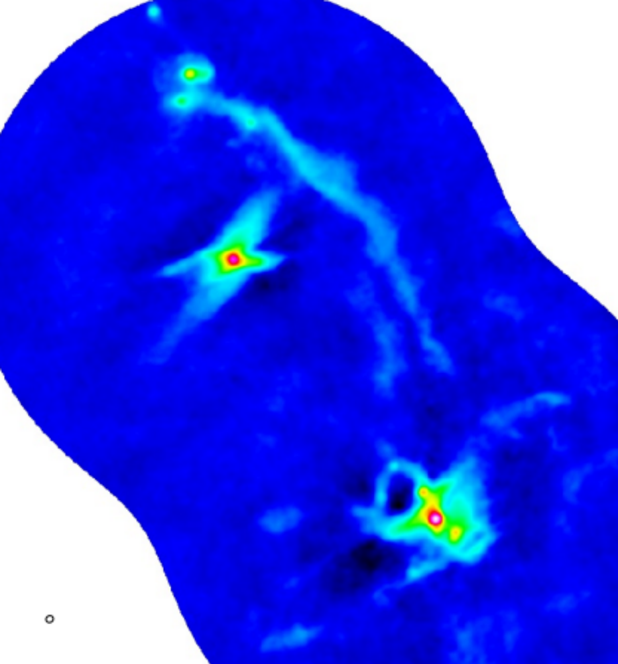
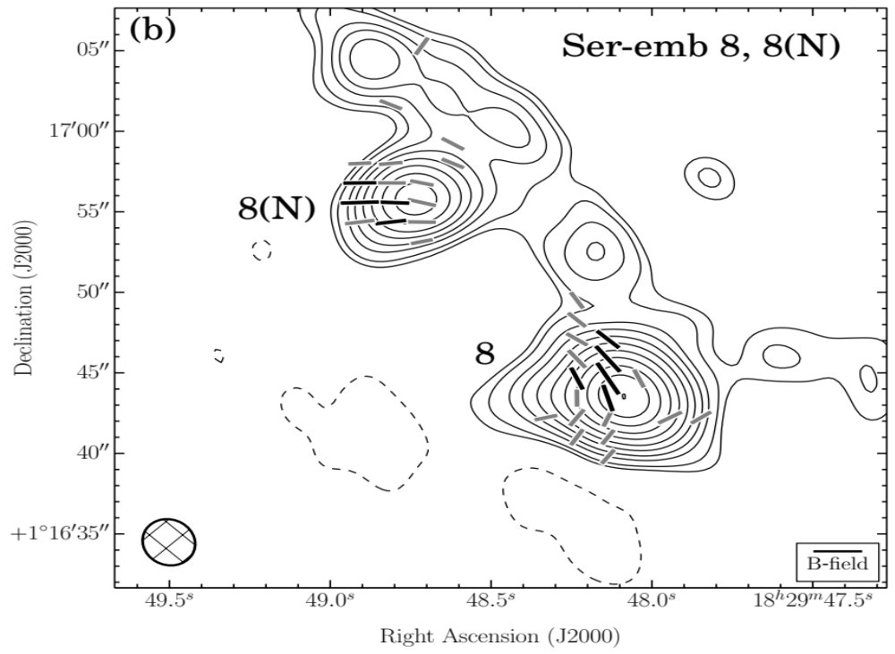
ALMA continuum + CARMA B-fields
Ser-emb 8, 8(N)
Colorscale
ALMA 850 um dust
Ser-emb 8, 8(N)
Hull+2016, in prep.
2000 AU

Slide 10
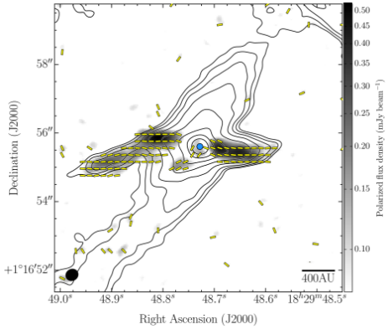
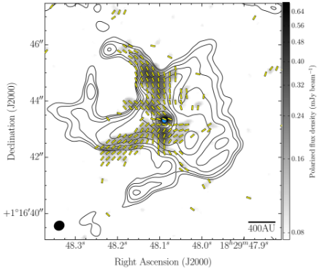
ALMA continuum + CARMA B-fields
Ser-emb 8, 8(N)
Background contours & white/gray line segments
CARMA data
Colorscale
ALMA 850 um dust
Inset
ALMA 850 um + B-field
Ser-emb 8, 8(N)
Hull+2014
Hull+2016, in prep.
2000 AU

Slide 11
ALMA continuum + CARMA B-fields
Ser-emb 8, 8(N)
Background contours & white/gray line segments
CARMA data
Colorscale
ALMA 850 um dust
Inset
ALMA 850 um + B-field
Ser-emb 8, 8(N)
Hull+2014
Hull+2016, in prep.
2000 AU

Slide 12

ALMA polarization data – Ser-emb 8(N)
outflows
magnetic fields
850 micron dust emission
polarized dust emission
sources
500 AU
Hull+2016, in prep.; see poster

Slide 13
ALMA continuum + CARMA B-fields
Background contours & white/gray line segments
CARMA data
Colorscale
ALMA 850 um dust
Inset
ALMA 850 um + B-field
Ser-emb 8, 8(N)
Hull+2014
Hull+2016, in prep.
2000 AU

Slide 14

ALMA polarization data – Ser-emb 8
outflows
Magnetized accretion flow?
magnetic fields
850 micron dust emission
polarized dust emission
sources
500 AU
Hull+2016, in prep.; see poster

Slide 15
Simulations

Slide 16
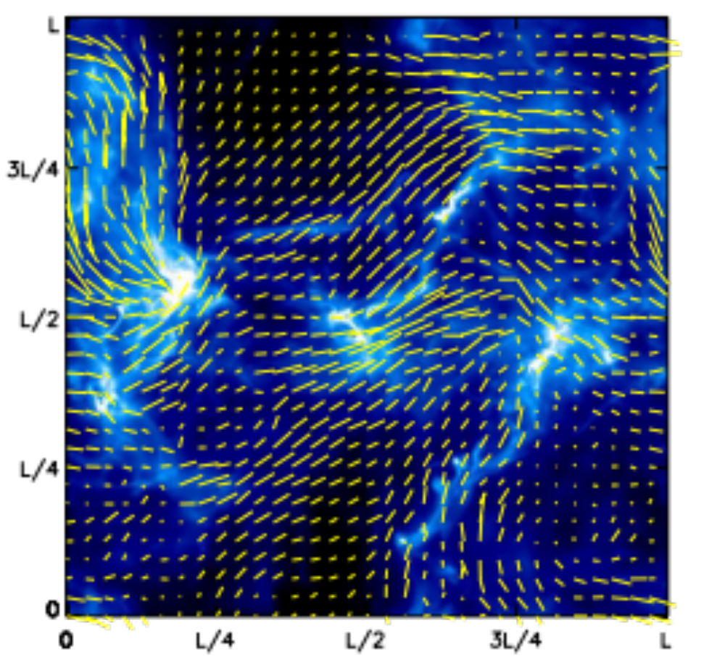
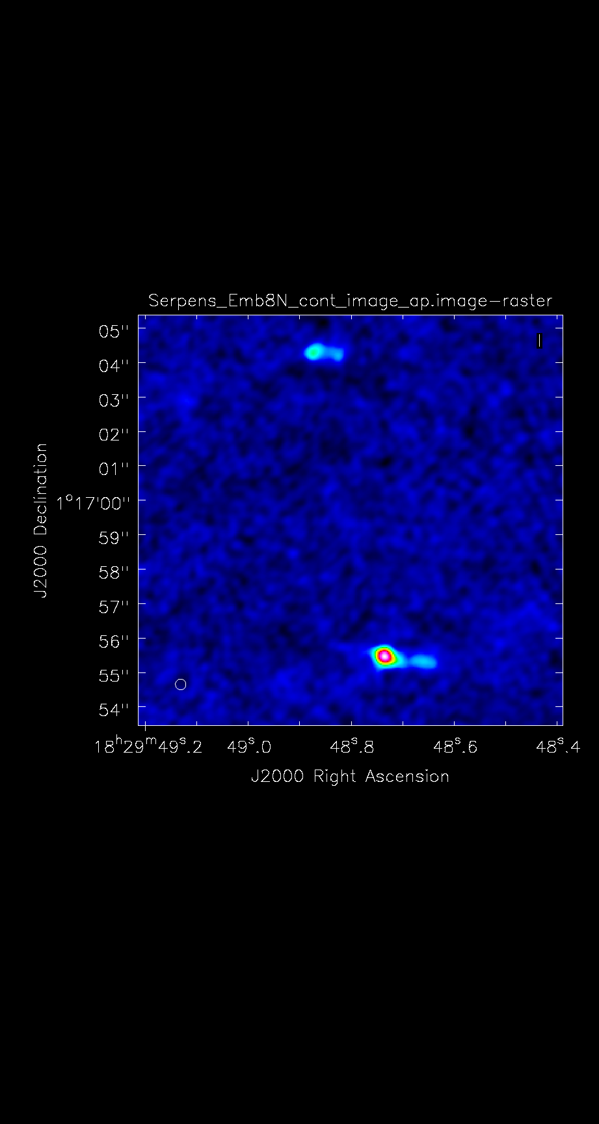
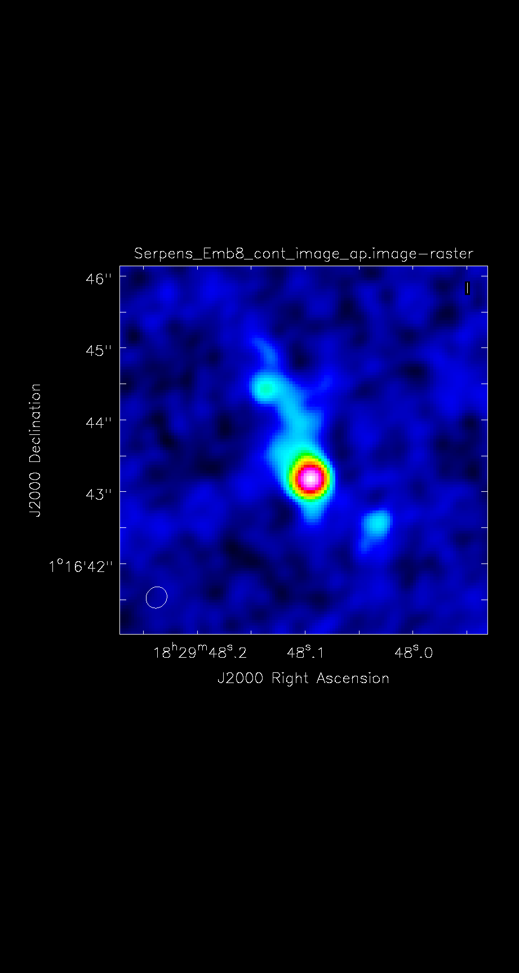
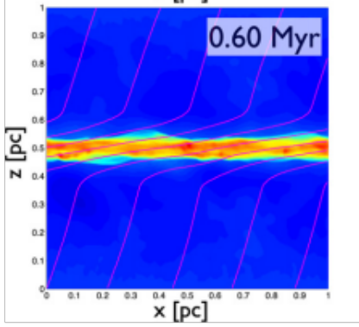
1 pc
Simulations & observations
CARMA and ALMA!
So tiny!
Soler+2013
Chen & Ost. 2014

Slide 17
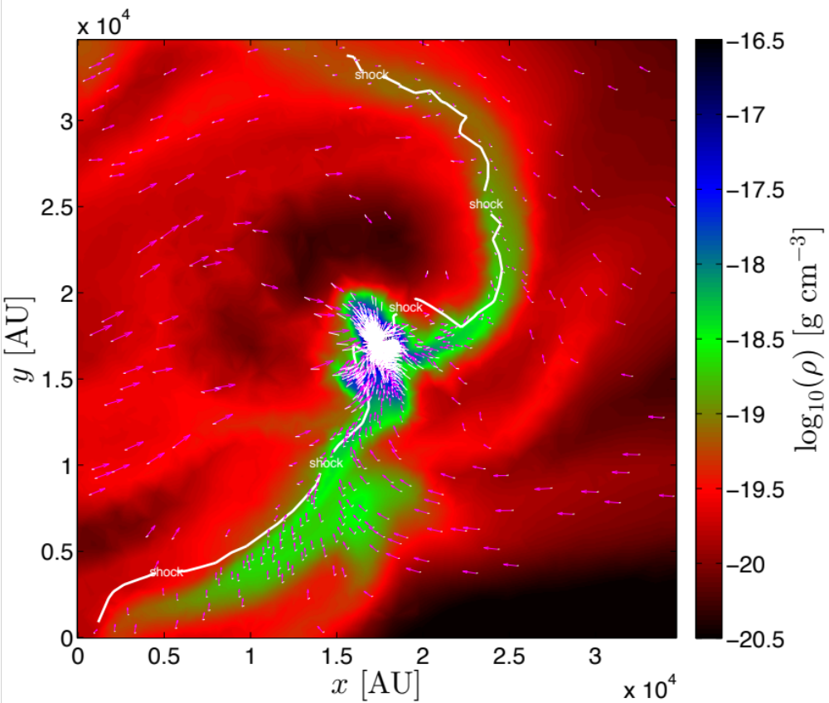
AREPO: the next generation
Star-forming core
Vectors
velocity
White line segments
B-field
Colorscale
density
0.1 pc
Philip Mocz, Blakesley Burkhart, & the Hernquist group (in prep.)
Notes:
Density scaling: 1e-20.5 g/cc (red), 1e-16.5 (blue)

Slide 18
AREPO: the next generation
Hull+2014
0.1 pc
Philip Mocz, Blakesley Burkhart, & the Hernquist group (in prep.)
Notes:
Density scaling: 1e-20.5 g/cc (red), 1e-16.5 (blue)

Slide 19
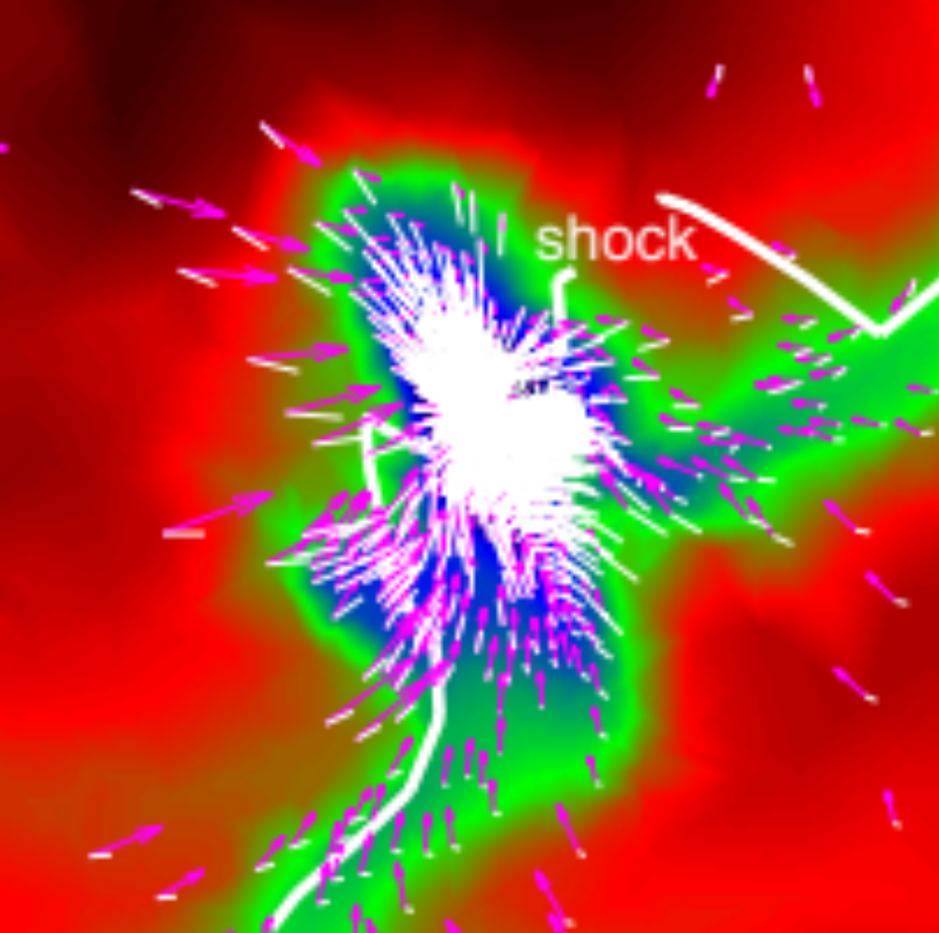
AREPO: the next generation
Hull+2014
Hull+2016, in prep.
2000 AU
Philip Mocz, Blakesley Burkhart, & the Hernquist group (in prep.)
Notes:
Density scaling: 1e-20.5 g/cc (red), 1e-16.5 (blue)

Slide 20
Summary (1/2)
Striking similarity between ALMA data and AREPO simulation
B-fields & filaments are aligned (parallel)
Seeing first evidence for magnetized accretion flows onto protostars?

Slide 21
Scattering?

Slide 22
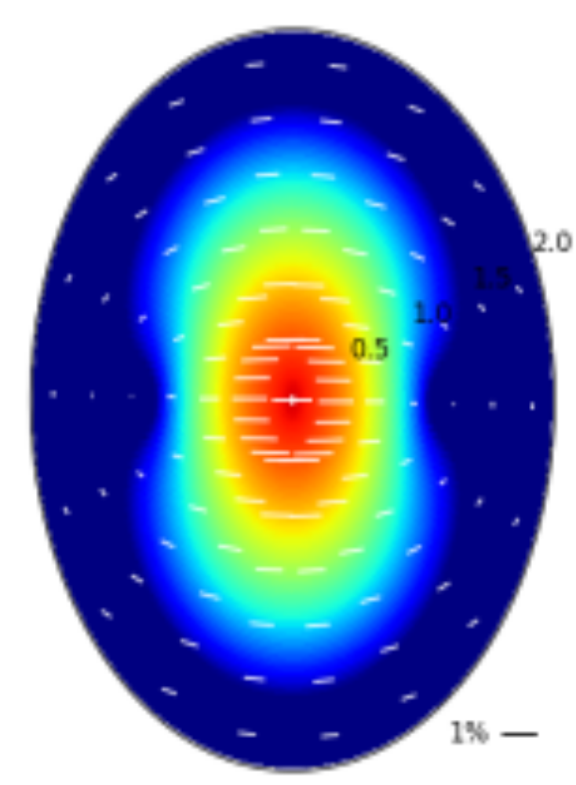
Polarization – mm-wave scattering
High optical depth and/or grain growth could lead to
polarization from scattering instead of from dust-grain alignment
E
Yang+2015
See also Kataoka 2015a, 2015b

Slide 23
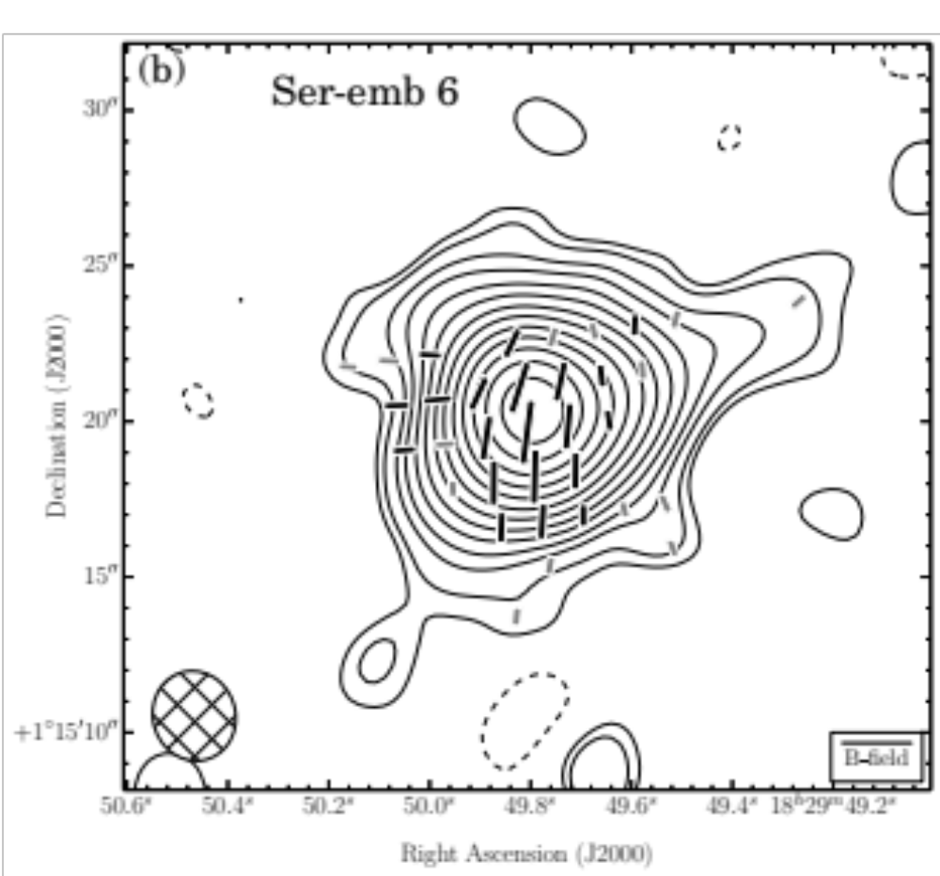
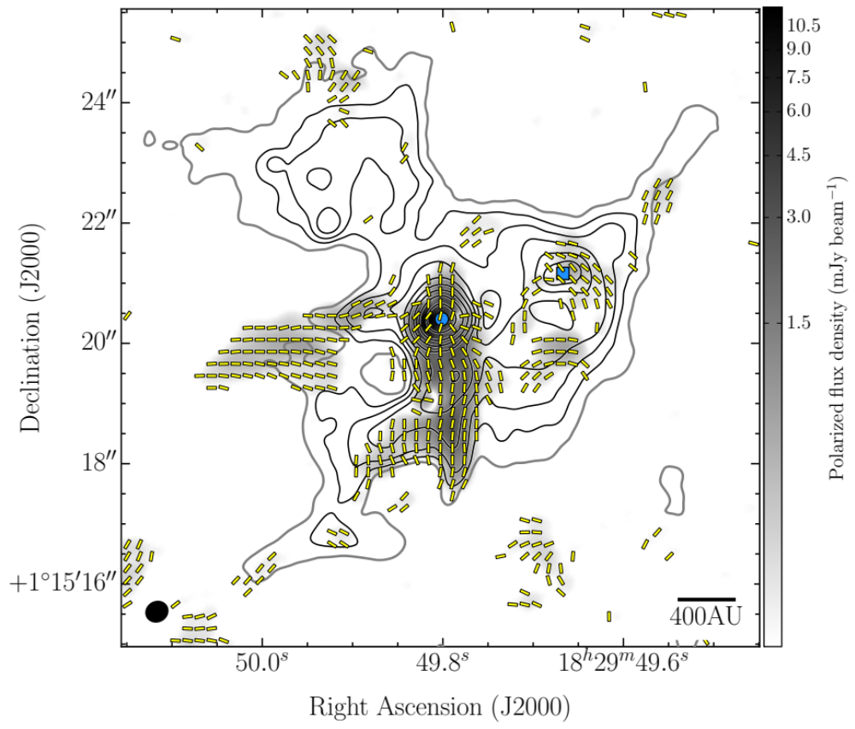
ALMA polarization data – Ser-emb 6 (FIR1)
Background
CARMA 1mm
Inset
ALMA 850 um
2000 AU
500 AU
Hull+2016, in prep.

Slide 24
ALMA polarization data – Ser-emb 6 (FIR1)
B-fields compressed along outflow cavity?
Scattering?!
High-velocity outflow (~100 km/s)
See Hull+2016
ApJL 823, L27
Hull+2016, in prep.; see poster

Slide 25
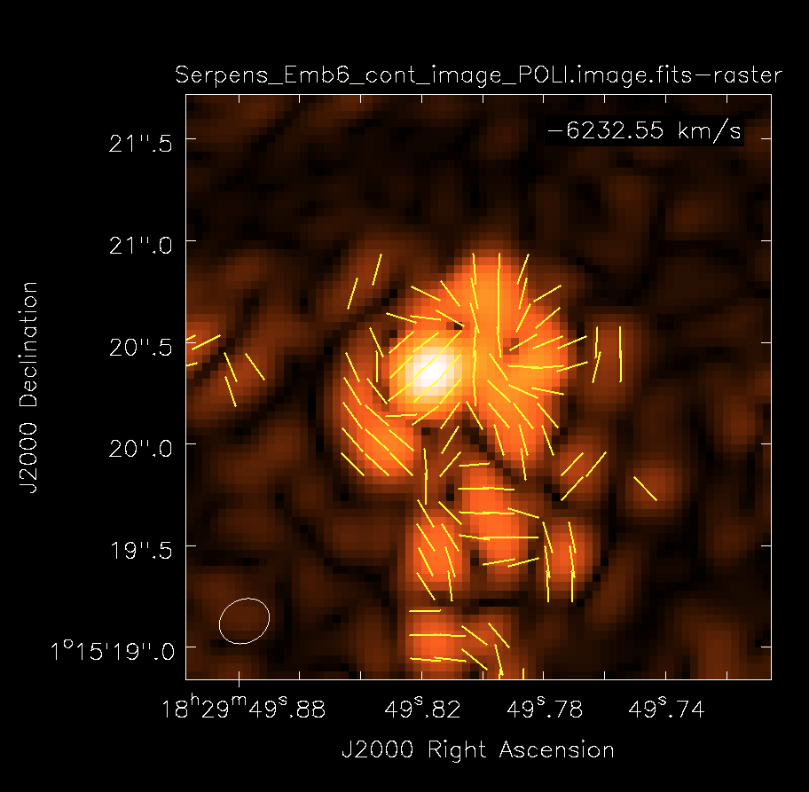
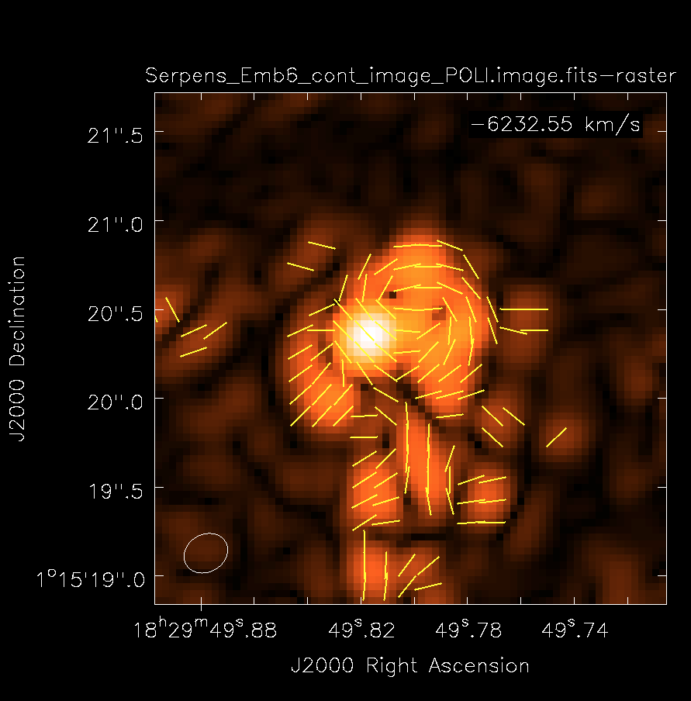
ALMA polarization data – Ser-emb 6 (FIR1)
B-field
E-field
PRELIMINARY
Hull+2016, in prep.

Slide 26
Summary (2/2) – open questions
What new (or old) things can we learn from scattering? (Looking to the IR scattering community for answers)
How will we separate scattering from dust emission?
If scattering dominates, how do we see B-fields in disks? (Ref: F. Alves talk)
How about going to longer wavelengths (Baobab’s talk), and what about scattering at those wavelengths?
Best tracers for definitively detecting infall along magnetized filaments?
Plans for high-resolution simulations to match the highest-resolution ALMA data? (Cycle 4: 0.034ʺ is <10 AU at Band 7 @ d =140 pc) Sink particles? Other considerations?
How do we treat polarization fraction, non-detections, and different spatial structure of total intensity and polarized emission?

Slide 27
Fin

